Slide 1

Welcome to the CGF
WHS Rules of Handicapping & DataGolf Education
22 January 2020
Notes:
Welcome and Introductions
• Welcome everyone
• Introduce yourself and the other instructors
• Explain the programme for the day
• Invite people to ask questions but stress there is a schedule/program that needs to be
adhered to.
• Complicated and specific questions may be best asked at break times.

Slide 2
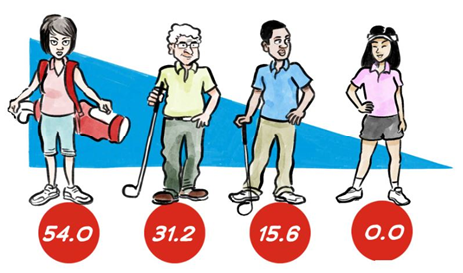
WHS - Content
Background to WHS initiative
Fundamentals of Handicapping
Handicap Formula
Committee Responsibilities
Implementation Plan
Notes:
Brief background to put the initiative into context
Fundamentals – will cover core foundations and elements of the new Rules: How do I get a handicap? How do I use it?
Formula – getting under the hood of the Rules to learn about how handicaps will be calculated under the new Rules
Handicap Committee – while we have worked hard to ensure that the system does as much of the hard work as possible, there can be no substitute for human intervention
Implementation plan – what will be happening (what we will be doing/what you need to be doing) between now and 2020 to prepare for transition

Slide 3
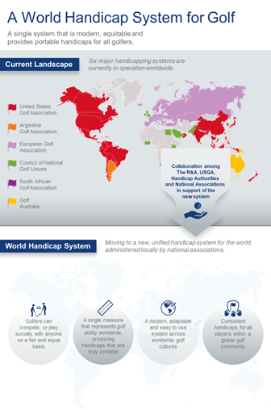
Background
Six systems in place today.
Each system aims to measure a golfer’s potential ability and provide equity for play.
But they do it differently, creating differing results and causing complications at the interface.
Golf already has a unified set of playing Rules, one set of Equipment Rules and one code for Amateur Status.
The time is right to introduce a unified handicap system.
Notes:
Example: Under current landscape, two golfers with identical scoring records, coming from different parts of the world could have a different ‘handicap’.
When these two golfers come together and play, they cannot have a fair and equal game.
When representatives of each of the current handicap authorities first came together to discuss the concept of a unified handicap system – back in 2012 – they agreed the time was right.

Slide 4
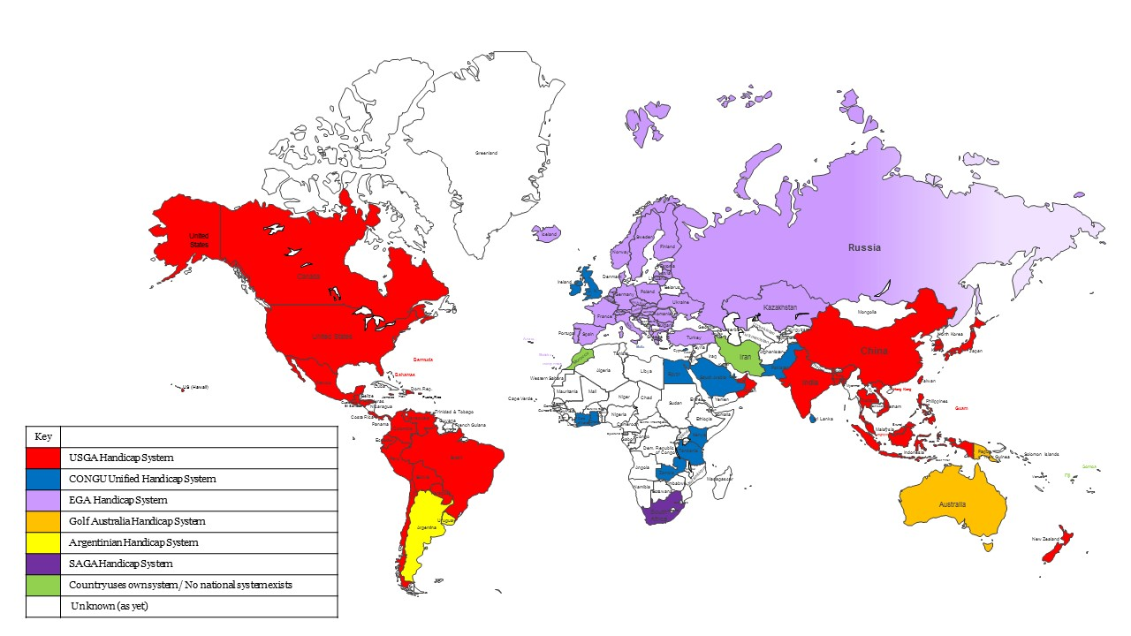
Current landscape
Notes:
Point out where the different systems are used from this map.

Slide 5
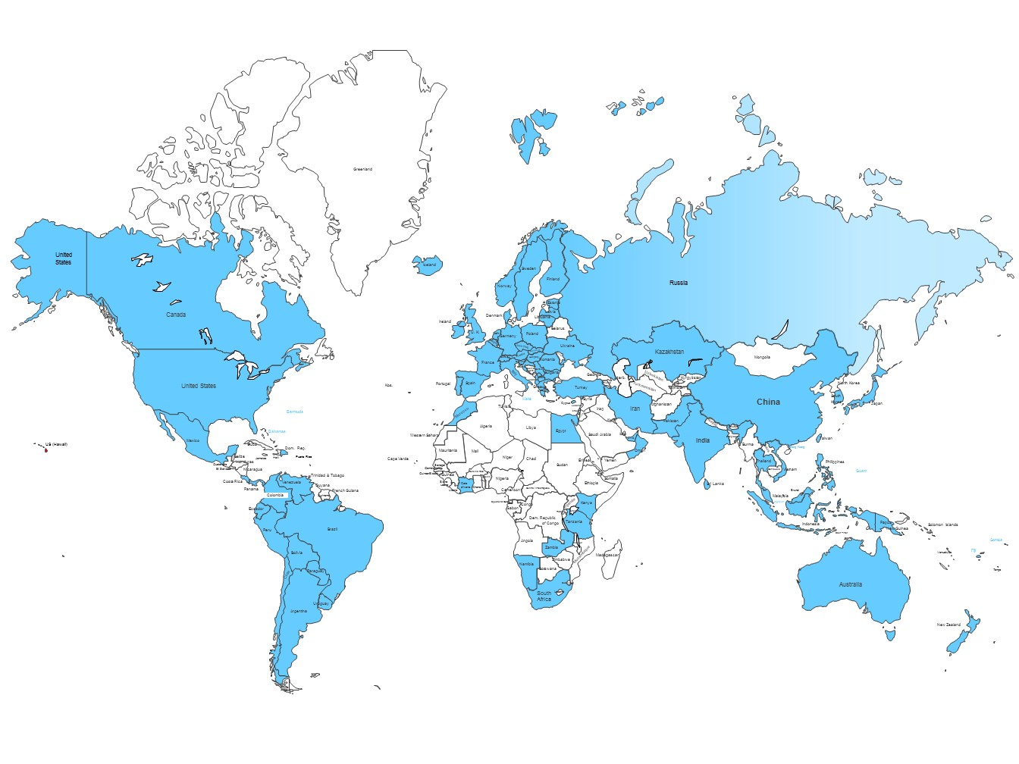
Notes:
….to this

Slide 6
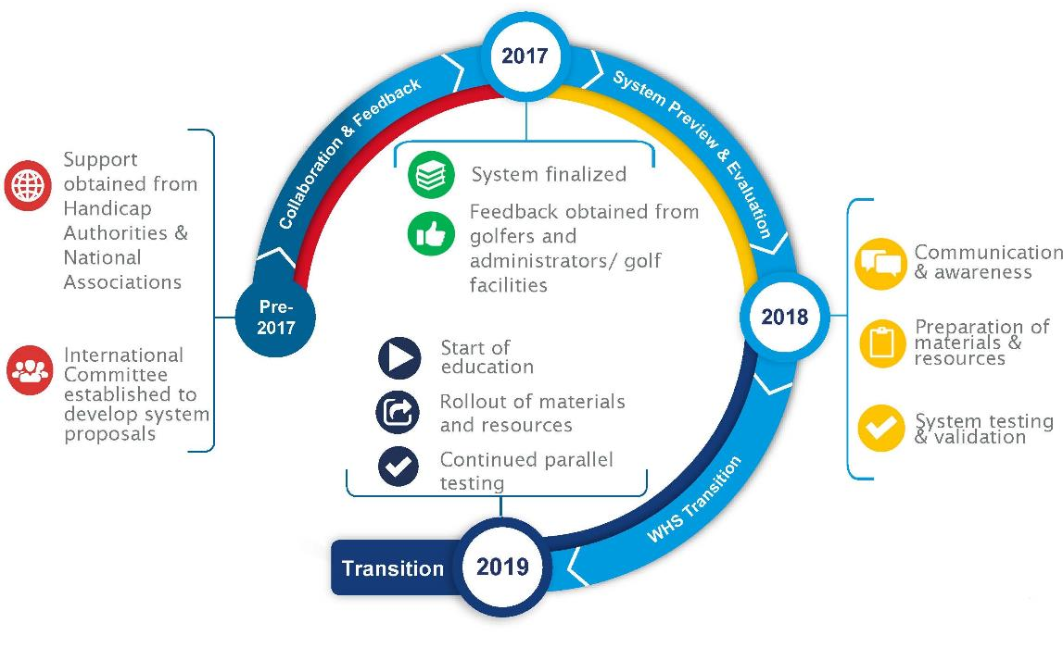

Progress since 2012
Notes:
Timeline tries to pick out some of the key phases of this project and shine a light on what we have accomplished so far.
This has been a massive collaborative project – with the involvement of many, many representatives of many different Federations.
Between 2012 and 2016 – we really spent much of our time meeting with each of the existing handicap authorities and agreeing the key principles of the new system. We then went on the garner support for those principles from other Federations around the world and only once we had received that support did we put a formal Committee structure in place – with representation for all corners of the globe – to build a system based upon those agreed principles.
Once 2017 was finished – much of the system was agreed. We had carried out a full review of each of the 6 existing systems and taken some of the most successful elements of each and tried to piece them together in such a way that worked as a cohesive and effective unit all around the world.
A lot of research has been carried out, and all aspects of the new system has been tested out on the data which has been supplied by Associations around the world.
2017 also saw us sharing our concepts with golfers and administrators through market research and 2018 saw us rolling up our sleeves to prepare all of our materials to assist the transition and launch.
This brings us up to date

Slide 7










Key Principles and Key Elements
Minimal Number of Scores to Obtain a Handicap
Abnormal Course & Weather Conditions Adjustment
Daily Revisions
54.0 Max Handicap
Inclusive & Accessible
Consistent & Portable
Calculation based on ability (with memory)
Modern & Adaptable
Integration of 9-hole Scores
Maximum Hole Score (Net Double Bogey)
Playing Handicap Course/Slope Rating & Par
Accommodating Local Cultures
Acceptable Scores for Handicap Purposes
Notes:
3. Modern and adaptable – real time updates of your Handicap Index in a time when people seem to want and expect everything NOW! Also – a system which is not intended to force change on the way golf is played in any given country. So – local cultures will be respected and accommodated. How?

Slide 8

Cultural Flexibility
Formats of Play.
Pre-registration.
Minimum number of holes for an 18-hole score to be acceptable.
How initial scores must be submitted.
Whether adjustments must be ratified and in what circumstances.
Notes:
The Rules give National Associations scope to make certain choices, to ensure the system suits the playing culture within their jurisdiction.
This slide shows examples of the choices available to EGA Member Federations – but perhaps the best example is the format of play that is acceptable for handicap purposes.
The decision as to which formats of play are acceptable for handicap purposes will be a decision for the National Association.
This means that local playing cultures can be respected - and so a culture which is predominantly recreationally based, will not be obliged to play more competition and vice versa. A country that is more stroke play based will not be obliged to play more match play.
A good variety of formats will be on offer and it will be up to Associations to select the formats that give golfers in their jurisdiction enough opportunity to submit scores – to enable them to have a Handicap Index that best reflects their demonstrated ability.
Without that evidence – the picture as to what kind of golfer they are will be less clear.

Slide 9

The Rules of Handicapping
Consist of 7 Rules:
1. Purpose and Authorisation; Obtaining a Handicap Index.
2. Scores Acceptable for Handicap Purposes.
3. Adjustment of Hole Scores.
4. Submitting a Score.
5. Handicap Index Calculation.
6. Course Handicap and Playing Handicap Calculation.
7. Committee Actions.
Follows similar template to Rules of Golf.
Drafted using simple, plain language.
Each prefaced with a Principle Statement – setting out the philosophy behind the Rule.
There are also 7 Appendices, which contain further, more detailed information about the Rules.
Interpretations, examples and illustrations.
Notes:
The “Rules of Handicapping” consist of seven Rules.
The layout follows a similar structure to the Rules of Golf, using simple, plain language – in International English
Each Rule is prefaced with a Principle statement – which is a very brief overview as to what the Rule is trying to accomplish.
Emphasis to keep the core Rules as clear and uncluttered as possible…so much of the detail is contained within the Appendices…
Supplementary interpretations, examples and illustrations to provide practical implementation on a Rule.

Slide 10

Fundamentals of Handicapping

Slide 11
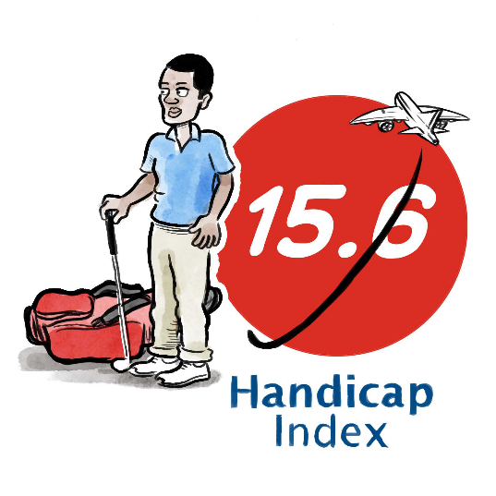
Rule 1.1 - Purpose of the World Handicap System
The World Handicap System includes the Rules of Handicapping and the Course Rating System.
Its purpose is to enable as many golfers as possible the opportunity to:
Obtain and maintain a Handicap Index.
Use their Handicap Index on any golf course around the world.
Compete, or play recreationally, with anyone else on a fair and equal basis.
Notes:
This is an opportunity to stress 3 aspects of the key principles of the WHS:
A system that is as INCLUSIVE and welcoming as possible – to make it as easy as possible for golfers to obtain and maintain a handicap
A system which gives golfers worldwide a handicap which is PORTABLE, from course to course and country to country
A system which calculates handicaps worldwide CONSISTENTLY, and enables golfers from all over the world to be able to come together and play together equitably.

Slide 12
Equity - for all Players
The whole purpose of a golf handicap system is to provide equity for all players.
To level the “playing field” - enabling players of all abilities to have a fair and enjoyable game, with or against any other players.
Our challenge was define equity. What is it? Views differed widely.
The World Handicap System has been designed to consider fairness for all players within its key features.
Enabling all golfers to play on a fair and equal basis
Notes:
Expanding on the question of equity:
Achieving equity amongst players is the whole purposes of a handicap system
But defining ‘what is equity’ has been a challenge – given that there was no single definition used by the existing 6 systems. They were each slightly different: Chance of winning; Chance of finishing in the top 5; Chance of finishing in top 25%, etc.
In the end, it was decided not to specifically define what equity means within the WHS – but to simply develop a system which is fair to all golfers.

Slide 13
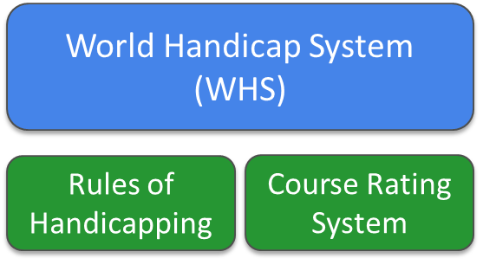
Foundation of the Rules of Handicapping
The USGA’s Course Rating System is already in use extensively around the world.
It makes sense for it to come under the WHS umbrella and form the foundation for the Rules of Handicapping.
The system enables handicaps to be portable by adjusting a player’s handicap according to the relative difficulty of the golf course being played.
Notes:
The USGA Course Rating System is already in use in over 80 Countries
Therefore, logical not to reinvent the wheel and to adopt the Course Rating System in its current form, under the WHS umbrella – where it will be known as simply the ‘Course Rating System’.
Allows PORTABILITY of handicaps to any (rated) set of tees on any golf course

Slide 14
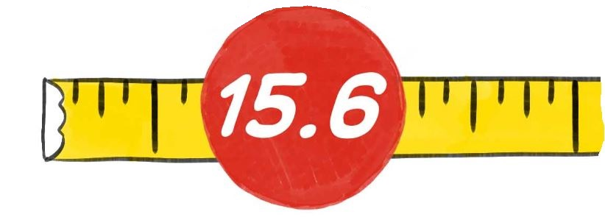




Course Rating and Slope Rating
Key Terminology
 | Handicap Index | The measure of a player’s demonstrated ability calculated against the Slope Rating of a golf course of standard playing difficulty
 | Course Rating | The difficulty of a course for the scratch player under normal conditions.
 | Slope Rating | The relative difficulty of a course for bogey players compared to scratch players
 | Scratch Player | A player with a 0.0 Handicap Index.
 | Bogey Player | A player with a Handicap Index of about 20.0 for men; 24.0 for women.

Slide 15
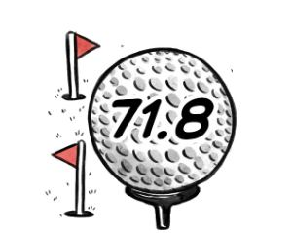
What is a Course Rating?
The evaluation of the playing difficulty of a course for scratch golfers under normal course and weather conditions.
Based on yardage and other obstacles to the extent that they affect the scoring difficulty of the scratch golfer.
Expressed as the number of strokes taken to one decimal place.
Notes:
Scratch Golfer 0.0 Handicap Index
Course Rating represents the score a scratch player should achieve under normal course and weather conditions
Though presented to one decimal place, the Course Rating of 71.8 would equate to a scratch golfer’s expected score of 72

Slide 16

What is a Bogey Rating?
The evaluation of the playing difficulty of a course for bogey golfers under normal course and weather conditions.
Based on yardage and other obstacles to the extent that they affect the scoring difficulty of the bogey golfer.
Expressed as the number of strokes taken to one decimal place.
Notes:
Same principle for the bogey golfer – expected score 95

Slide 17
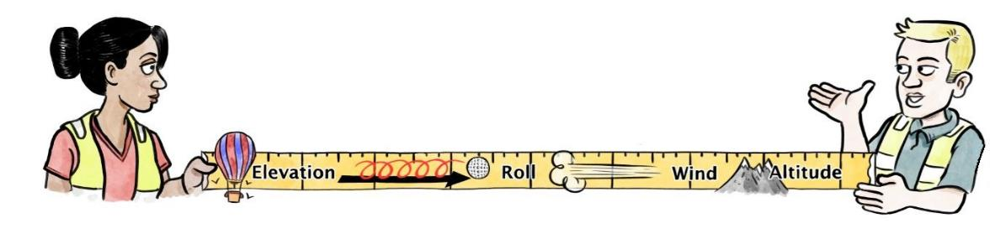
What is Assessed When Rating a Golf Course?
Length | Obstacles (Difficulty Factors)
Measured length of hole | Topography | Penalty Areas – Lateral
Roll | Fairway | Penalty Areas – Crossing
Elevation | Green Target | Trees
Doglegs/Forced Lay-ups | Recoverability from Rough | Green Surface
Wind | Bunkers | (Psychological)
Altitude
Notes:
Obstacles represent the difficulties and challenges posed to scratch and bogey golfers
9 obstacles are assessed within each landing zone and around each green
List includes ‘Penalty Areas’, as introduced within the 2019 Rules of Golf
Penalty Areas include what used to be called Water Hazards as well as Out of Bounds and Extreme Rough. These obstacles are assessed from both a Crossing and Lateral perspective
The 10th obstacle – Psychological - is automatically calculated (relative to how many of the other obstacles have been rated 5 or greater)

Slide 18
366
256
238
192
174
137
119
Women’s Landing Zones
41 m
0
430
338
320
229
211
183
165
Men’s Landing Zones
450 [380] YARDS, PAR 4
Notes:
Illustration of two holes that are similar in length and layout, but very different with design of its obstacles.
First course is displayed here -
Men and women’s landing zones highlighted on this simple, straight forward hole, with little obstacle difficulty
One bunker at the front of the green, wide generous fairway

Slide 19

366
256
238
192
174
137
119
Women’s Landing Zones
OOB
16 m
41 m
0
430
338
320
229
211
183
165
Men’s Landing Zones
450 [380] YARDS, PAR 4
Notes:
Second course is displayed here -
Same hole, same length now shows a very different picture
Additional obstacles have been added over time – Penalty Areas, Trees, additional bunkers, Out of Bounds behind the green….

Slide 20
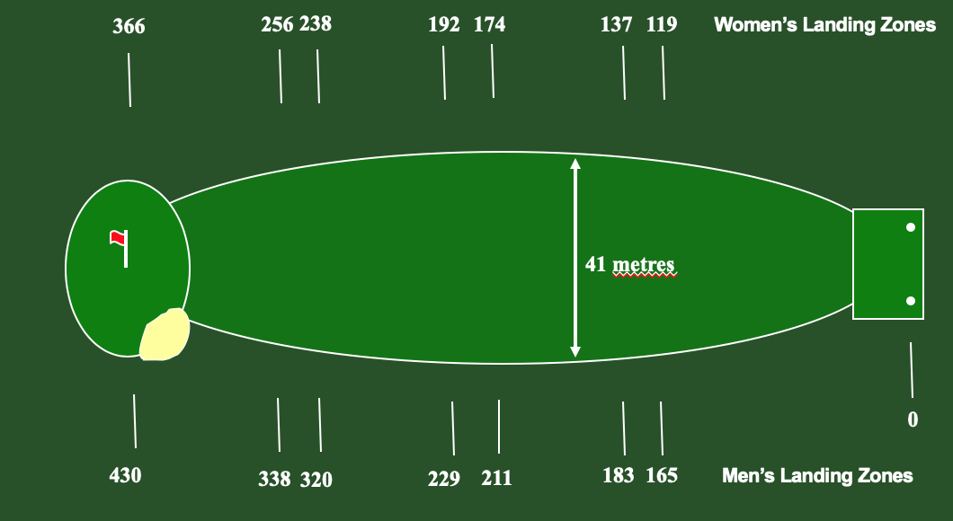
Foundation of the Rules of Handicapping
The system enables handicaps to be portable by adjusting a player’s handicap according to the relative difficulty of the golf course being played.
This means that a player’s Handicap Index will be converted into the number of strokes needed to play the course ‘to handicap’.
This makes sense, given that the player will likely need a different number of strokes to play these two courses.
Notes:
PORTABILITY - The WHS provides players with the required number of strokes to play any course…
…through a calculation that considers the players Handicap Index and the difficulty of the golf course being played
Hopefully, you all agree you might need some additional strokes to play the bottom golf course – especially if all 18-holes are like this!

Slide 21
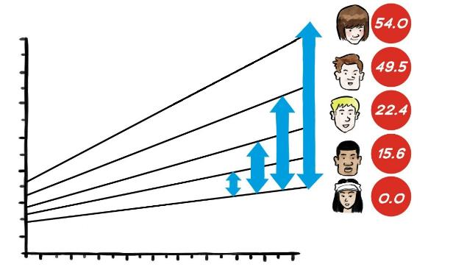
What is a Slope Rating?
A Slope Rating is the number which indicates the relative playing difficulty of a course for bogey golfers, compared to scratch golfers.
It is the combination of the Course Rating and the Bogey rating that allow us to calculate the Slope Rating of a set of tees.
Notes:
To recap – the Course Rating is the score that a scratch golfer is expected to score; the Bogey Rating is the score a bogey player is expected to score
The Slope Rating represents the difference between the two – i.e. the relative difficulty (playing from a specific set of tees on a golf course) for the Bogey player compared to the Scratch player
The Slope Rating is, therefore, a key component in the calculation of the number of strokes each player receives to play a particular golf course

Slide 22
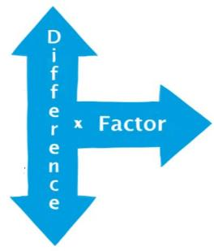
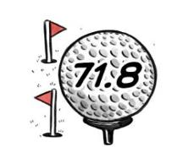

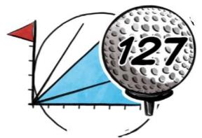
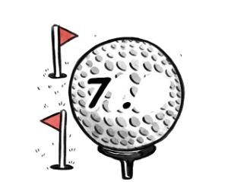
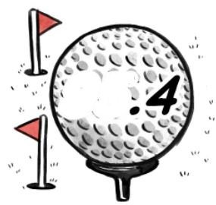
What is a Slope Rating?
It is the difference between the Bogey Rating and the Course Rating multiplied by a constant factor. (Men 5.381 & Women 4.24)
It is expressed as a whole number from 55 to 155. A golf course of standard relative playing difficulty has a Slope Rating of 113.
Scratch Bogey
Man
Woman
.
2.
4
102
Notes:
The difference between the Scratch and Bogey Ratings multiplied by a constant factor calculates the Slope Rating
Factors:
Men – 5.381
Women – 4.24

Slide 23

Rule 2 - Scores for Handicap Purposes
Principle of the Rule:
The scores a player submits for handicap purposes are at the core of the calculation of their Handicap Index.
Rule 2 covers the conditions a score must satisfy for it to be acceptable for handicap purposes, providing confidence that it will produce reasonable evidence of the player’s ability and, ultimately, a Handicap Index that reflects this.

Slide 24


Rule 2.1 - Acceptability of Scores
Rounds played:
In an authorised format of play.
Over a minimum number of holes.
By the Rules of Golf.
With at least one other person or player.
On a course with a current Course Rating and Slope Rating.
During an active season.
Certified in accordance with Rules of Handicapping.
Notes:
The course must have a current Course and Slope Rating
The round must be played during an active season
In some areas, at certain times during the year, the weather and ground conditions are so far removed from ‘normal’ that scores for handicap purposes are meaningless – and could unduly distort a player’s Handicap Index, e.g. the grass goes dormant and the course difficulty does not reflect the current Course Rating and Slope Rating. Therefore, an Authorised Association is able to set a timeframe for when scores are acceptable for handicap purposes – and while golf may be played outside of this timeframe – the scores should not be submitted for handicap.
The score must be certified (see next slide)

Slide 25


Rule 2.1a - CGF Authorised Formats of Play
Format of Play | Type of Round | Number of Holes
Individual Stroke play | Organized competition | 9 |  | 18
 | General play | 9 |  | 18
 | Stableford – organized competition | 9 |  | 18
 | Stableford – general play | 9 |  | 18
 | Par / bogey – organized competition | 9 |  | 18
 | Par / bogey – general play | 9 |  | 18
 | Maximum Score – organized competition | 9 |  | 18
 | Maximum Score – general play | 9 |  | 18
Notes:
An example of the choices that could be made…

Slide 26



Rule 2.1a (iii) - Pre-Registration
Within the CGF players are required to pre-register their intent to submit a score in general play for handicap purposes.
Such pre-registration must be made:
Before the player starts the round, and
In the manner prescribed by the Handicap Committee.
The registration process will be as easy as using the clubs existing EDS books.
A player can be considered to have pre-registered their intent to submit a score if playing in a regular, organised event with other players.
Notes:
This feature is included in the system primarily for those jurisdictions that are coming from a culture where scores are generally only acceptable for handicap purposes if played in a competition
The process of pre-registration of recreational rounds for handicap purposes should offer a level of comfort that players cannot pick and choose when to submit a score – perhaps during or after a round has been played.
Discretionary Item - this slide can be removed/amended at the discretion of the National Association

Slide 27
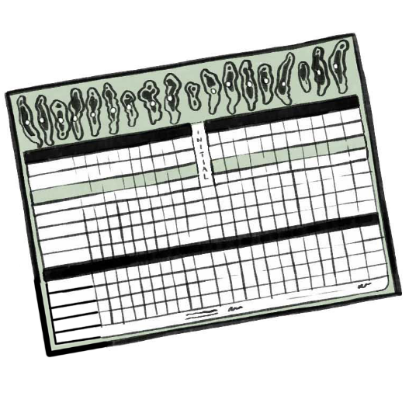
Rule 2.2a - Minimum Number of Holes for an 18-hole score
For an 18 - hole score to be acceptable for handicap purposes all 18 holes must be played.
However if a player has played more than 9 holes - but less than 18 holes – the score may count as a 9-hole score.
Notes:
The Rules of Handicapping set a minimum number of holes required for a score to be acceptable for handicap purposes. This is for a number of reasons, including:
There are circumstances when extreme weather or injury may prevent players from completing their rounds, but the information derived from the holes already played is still valuable for handicap purposes.
While incomplete, it is still evidence of the player’s ability
We will deal with what score to record when a hole is not played later in the presentation.
It is a National Association’s decision as to how many holes a player needs to complete in order for an 18-hole score to be acceptable – between 10 and 18 holes. This decision can be based on:
The choice made on authorized formats of play
The playing culture with that jurisdiction
If the minimum number of holes is not played, the score is not acceptable for an 18-hole score. However, it might be acceptable as a 9-hole score.

Slide 28
Rule 2.2b - Minimum Number of Holes for a 9-hole score
For a 9-hole score to be acceptable for handicap purposes then all 9 holes must be played.
If a player has completed less than 9 holes, the score is not acceptable.
Notes:
If an Association has elected to authorize 9-hole scores for handicap purposes, all 9 holes must be played.

Slide 29
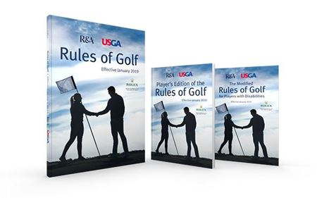
Rule 2.1b - Playing by the Rules of Golf
A round must be played by the Rules of Golf to be acceptable for handicap purposes.
EXCEPTION:
When a player is disqualified from a competition, but no significant advantage has been gained, the score should remain acceptable for handicap purposes.
For example, failure to sign a scorecard in stroke play.
The final determination is at the discretion of the Committee.
Notes:
From the early stages of this project, there was interest in trying to ensure as far as possible that rounds of golf played for handicap purposes are played by the Rules of Golf.
However, there are instances where a Rule of Golf may not have been followed – but it would make no sense for the score not to be used for handicap purposes.
For example, when a player has been disqualified for a technical breach of the Rules of Golf, such as failing to sign a scorecard, and no scoring advantage has been gained - the score could be acceptable.
Committees are best placed to determine the acceptability of scores in such situations for each individual member.

Slide 30

Rule 2.1b - Playing by the Rules of Golf
In General Play - a score is not acceptable for handicap purposes if the player is known to have:
Breached the Rules of Golf and the correct penalty has not been applied as prescribed by the Rules of Golf, or
Deliberately ignored the Rules of Golf.
EXCEPTION:
    When a player follows a Model Local Rule, not adopted by the Committee.
The final determination is at the discretion of the Handicap Committee.
Notes:
Recreational golf is harder to police, but the same principles apply.
A golfer is expected to play by the Rules and if they are known to have been in breach of the Rules and not applied the correct penalty, or they have deliberately ignored the Rules, then the score is not acceptable for handicap purposes
Exceptions could be where the player has followed a Model Local Rule that has not been adopted by the Committee. For example:
The player uses a distance measuring device, but the Local Rule prohibiting their use has been adopted,
The player uses the alternative method of stroke and distance, when the Local Rule has not been adopted
The final decision on this sits with the Handicap Committee.

Slide 31


Slide 32

Rule 6 - Course Handicap and Playing Handicap Calculation
Principle of the Rule:
For a Handicap Index to be portable, it must be converted into a Course Handicap to determine the number of strokes a player receives for the golf course being played.
For equity to be achieved amongst two or more players, a player’s Course Handicap must be converted into a Playing Handicap as determined by the format of play and the applicable handicap allowances.

Slide 33
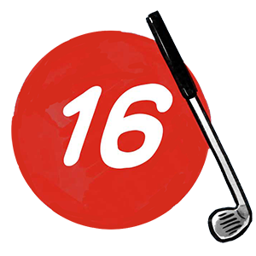
Rule 6.1 - Calculation of a Course Handicap
Key Terminology
 | Course Handicap | The number of handicap strokes a player receives from a specific set of tees as determined by the Slope Rating and Course Rating minus par. This does not factor in the format of play.

Slide 34
Rule 6.1 & 6.2 - Calculating a Course Handicap
For an 18-hole Round
x
+
Handicap Index
(Slope Rating ÷ 113)
(Course Rating - par)
For a 9-hole Round
x
+
(9-hole Course Rating –
9-hole par)
Handicap Index ÷ 2
(9-hole Slope Rating ÷ 113)
Notes:
18-hole: The Handicap Index is multiplied by the Slope Rating of the tees being play and divided by 113. Then add any difference between the Course Rating and the Par of the tees being played.
9-hole: The Handicap Index is halved and multiplied by the 9-hole Slope Rating of the tees being play and divided by 113. Then add any difference between the 9-hole Course Rating and the 9-hole Par of the tees being played.

Slide 35

Rule 6.2 - Calculation of a Playing Handicap
Key Terminology
 | Playing Handicap | The number of strokes player gives or receives for the round for a specified format of play.

Slide 36
Rule 6.2 - Playing Handicap Calculation
The calculation of a Playing Handicap is an adjustment to the Course Handicap by any handicap allowances in operation for the format of play:
The calculated Playing Handicap is conventionally rounded to the nearest integer with .5 rounding upward.
Limits on a maximum Playing Handicap can be prescribed within the Terms of the Competition
If different tees with different pars are in use for a competition, a player’s Playing Handicap may be adjusted by the difference in par – depending on the format of play (see Rule 6.2b).
=
x
Playing Handicap
Course Handicap
Handicap Allowance
Notes:
The Playing Handicap of a player with a maximum Handicap Index of 54.0 could be higher than 54.0.
Within the Terms of the Competition – the Committee may set a maximum Playing Handicap.
If a player has played a round since their Handicap Index was last updated, the Committee in charge of the competition may also decide to allot a different Playing Handicap.

Slide 37
Recommended Handicap Allowances
Formats of Play | Recommended Handicap Allowance | Formats of Play | Recommended Handicap Allowance
Individual stroke play | 95% | Best 1 of 4 stroke play | 75%
Individual stableford | 95% | Best 2 of 4 stroke play | 85%
Individual par / bogey | 95% | Best 3 of 4 stroke play | 100%
Individual Maximum Score | 95% | All 4 of 4 stroke play | 100%
Four-ball stroke play | 85% | Scramble (4 players) | 25%/20%/15%/10% from lowest to highest handicap
Four-ball stableford | 85% | Scramble (2 players) | 35% Low / 15% High
Four-ball par / bogey | 90% | Total score of 2 match play | 100%
Individual match play | 100% | Best 1 of 4 par / bogey | 75%
Four-ball match play | 95% | Best 2 of 4 par / bogey | 80%
Foursomes | 50% of combined team handicap | Best 3 of 4 par / bogey | 90%
Greensomes | 60% Low handicap + 40% high handicap | 4 of 4 par / bogey | 100%
Pinehurst/Chapman | 60% Low handicap + 40% high handicap
Notes:
The recommended allowances for Individual stroke/stableford/par/bogey formats of play are based on a medium-size field event (30 players or more).
For small-size field events, the recommendation would be to use 100%.

Slide 38
Relationship Between: Handicap Index, Course Handicap, Playing Handicap and Score Differential
Handicap Index
Course Handicap
Playing Handicap
Score Differential
Measure of player’s demonstrated ability
For adjusting hole scores for handicap purposes
Course Handicap + Handicap Allowances = Strokes Received
Value played to for the round
STEP 1:
Handicap Index is adjusted for Slope and the difference between Course Rating and par to provide player with the required number of strokes needed to play from a specific set of tees.
STEP 2:
Go out and play!
Adjust to format of play, using Handicap Allowances prescribed or recommended by Authorized Association.
STEP 3:
The Course Handicap should be used to adjust the score for net double bogey and net par and Score Differential is calculated, de-sloping back to a course of standard difficulty i.e. Slope Rating of 113
Notes:
This slide tries to summarise the relationship between the Handicap Index, the Course Handicap, the Playing Handicap and the calculation of the Score Differential.

Slide 40
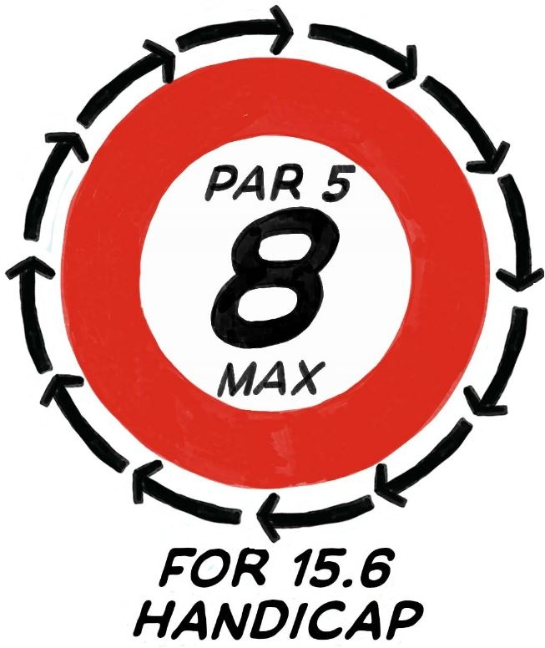
Rule 3.1 - Maximum Score for Handicap Purposes
Even the best golfers have bad holes.
The odd bad hole shouldn’t define (reflect) your ability.
The maximum hole score ensures that the bad holes don’t impact a player’s Handicap Index too severely.

Slide 41

Rule 3.1- Maximum Score for Handicap Purposes
Key Terminology
 | Net Double Bogey | A player’s maximum hole score for handicap purposes.

Slide 42
Rule 3.1 - Maximum Score for Handicap Purposes
The net double bogey adjustment sets a maximum score on any hole for handicap purposes, ensuring bad holes don’t impact a player’s handicap too severely.
=
+
+/-
+/- Handicap strokes received
or given on a hole
Net double bogey
Par
2
A player with a Course Handicap of 11 receives one stroke on the first 11 allocated stroke holes.
On a par-4 hole with a stroke index of 6, the player’s net double bogey score is calculated as follows:
Par
4
+
Two Strokes (Double Bogey)
2
+
Stroke(s) Received
1
=
Max
7

Slide 43
Rule 3.1 - Application of Net Double Bogey Adjustment
Sunnyside Golf Club
Bronze Tees Course Rating: 72.1 Slope Rating: 122
Name of Player: Janet Smith
Handicap: 18
Hole | 1 | 2 | 3 | 4 | 5 | 6 | 7 | 8 | 9 | Out
Par | 4 | 4 | 5 | 4 | 3 | 5 | 4 | 5 | 3 | 37
S.I. | 7 | 13 | 3 | 9 | 15 | 1 | 11 | 5 | 17
Score | 5 | 5 | 6 | 5 | 4 | 6 | 5 | 6 | 4 | 46
Score for Competition = 95
Score for Handicap Purposes = 94
Hole | 10 | 11 | 12 | 13 | 14 | 15 | 16 | 17 | 18 | In | Total
Par | 4 | 4 | 3 | 5 | 4 | 3 | 5 | 4 | 4 | 36 | 73
S.I. | 8 | 12 | 18 | 4 | 10 | 16 | 2 | 6 | 14
Score | 5 | 5 | 4 | 6 | 5 | 4 | 7 | 8 | 5 | 49 | 95
4
6
8
94
7 = Net double bogey adjustment of -1

Slide 44
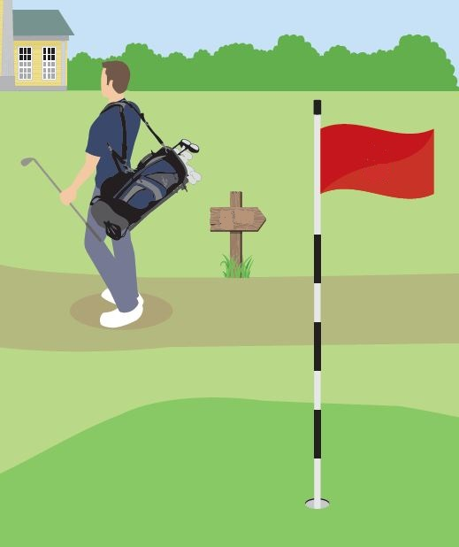
Rule 3.2 - When a Hole is Not Played
When a player has completed the minimum number of holes, but not the full 18 holes, a score of net par must be recorded for the holes not played.
EXCEPT:
If the number of holes played is greater than 9, but less than 14 holes, net par + 1 stroke must be added to the first hole not played.
16
17th

Slide 45

Rule 4 - Submitting a Score
Principle of the Rule:
Rule 4 covers the process for the submission of acceptable scores for handicap purposes, both to obtain an initial Handicap Index and to maintain an established Handicap Index.
Following timely submission of scores by the player or anyone else responsible or authorised to submit their score, responsive updates provide a real-time measure of a player’s golfing ability.
This Rule also outlines the information that players are required to submit for acceptable scores and how these scores can be validated, for example by a marker’s physical signature, by electronic certification or through peer review.

Slide 46

Rule 4.3 - Timeframe for Submitting a Score
A player should submit their score as soon as possible on the day of play, after completion of their round and before midnight (local time).
If scores are not submitted on the same day as they are played this will have an impact on the PCC for the day and software systems may not recognise the scores.
Players might be entered for a tournament the next day and failure to send any acceptable scores on the date of play might impact on a players next Q event.

Slide 47
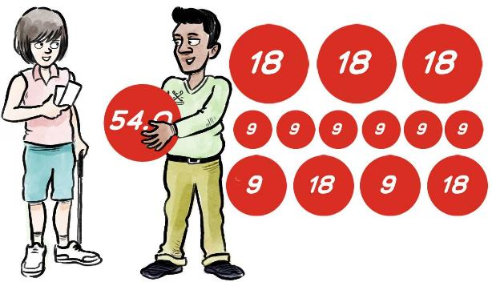
Rule 4.5 - Minimum Number of Scores to Get a Handicap
An acceptable score from a minimum of 9 holes.
Initial scores are submitted hole-by-hole to better assess the potential of the player.
Notes:
An overarching theme of the World Handicap System is to become more inclusive – and this feature will hopefully encourage golfers who only play sporadically to establish and maintain a Handicap Index.
It will be strongly recommended that a player’s initial three scores should be submitted hole-by-hole to enable clubs to better assess the player’s potential.

Slide 48
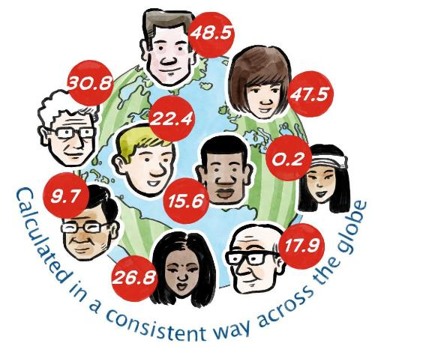
Rule 5 - Handicap Index Calculation
Principle of the Rule:
A player’s Handicap Index should represent their demonstrated ability and, where appropriate, be responsive to scores that are inconsistent with their demonstrated ability.
Rule 5 covers the process of calculating a Handicap Index and incorporates the safeguards needed to help ensure that a player’s Handicap Index remains reflective of their ability and that equity is retained for all golfers. It includes mechanisms which:
Take into consideration the conditions in which a score was played.
Remembers previously demonstrated ability within a defined period of time.
Caps the upward movement of a player’s Handicap Index within a defined period of time.
Applies additional adjustments to a player’s Handicap Index when an exceptional score is submitted.
Notes:
Key parts to highlight:
Demonstrated ability. A player’s HI is only as good as the evidence provided to calculate it. We have already covered the types of scores that will be used for handicap purposes – and it is important that these scores are good quality because they are at the core of the handicap calculation.
Safeguards. It is necessary for the system to include mechanisms to ensure that a player’s Index does not stray too far away from their demonstrated ability and to also make additional adjustments for exceptional performances.
Think of the calculation as having a series of layers… There is a basic calculation – which is at the core of every calculation – and then other layers are built up around that core – to safeguard it and make sure it is doing its job effectively.

Slide 49
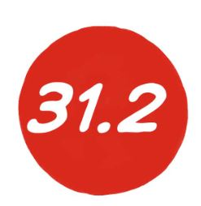

Rule 5.1 - Basic Calculation of a Score Differential
Key Terminology
 | Score Differential | The difference between a player’s adjusted gross score and the Course Rating, taking account of Slope Rating. It is the value ‘played to’ on a specific course on a specific day.
 | Adjusted Gross Score | A player’s gross score, including any penalty strokes, adjusted for when: The player exceeds their maximum hole score, A hole is not played, or A hole is started but the player does not hole out.
Notes:
For the purpose of calculating a Handicap Index, scores are converted into a score differential.
This is the value associated with how you played on a given golf course on a given day; some people might term this as what you “played to”.
Your Index is calculated using score differentials.
In converting a score into a score differential – we use either the player’s adjusted gross score or their Stableford points. The adjusted gross score is the player’s gross score (including any penalty strokes), adjusted for maximum hole score (net double bogey) and hole not played (net par).

Slide 50
Rule 5.1a - Basic Calculation of an 18-hole Score Differential
In stroke play formats (gross score, net score or Maximum Score), where scores are returned as hole-by-hole or adjusted gross score:
In Stableford and Par/Bogey formats, where scores are returned as points relative to par:
The result is rounded to the nearest tenth, with .5 rounded upwards.
x
(113 ÷ Slope Rating)
(Adjusted gross score – Course Rating)
x
(par + Course Handicap – (points scored – 36) – Course Rating)
(113 ÷ Slope Rating)
Notes:
Here are the two different calculations – firstly for adjusted gross score; secondly for Stableford points.
Both methods are doing exactly the same thing – comparing your actual score against your target (expected) score (the Course Rating) and should produce exactly the same result.

Slide 51
Rule 5.1a - Basic Calculation of an 18-hole Score Differential
=
x
Score Differential
(113 ÷ Slope Rating)
(Adjusted gross score – Course Rating)
Examples:
A player’s adjusted gross score is 95 on a course with Course Rating of 71.5 and Slope Rating of 125.
The player’s Score Differential is:
(113 ÷ 125)
0.904
x
(95 – 71.5)
23.5
Score Differential
21.2
=
A player’s adjusted gross score is 97 on a course with Course Rating of 73.8 and Slope Rating of 140.
The player’s Score Differential is:
(113 ÷ 140)
0.807
x
(97 – 73.8)
23.2
=
Score Differential
18.7
Notes:
Here are a couple of examples using the adjusted gross score calculation. The final value (Score Differential) is rounded to one decimal place.

Slide 52
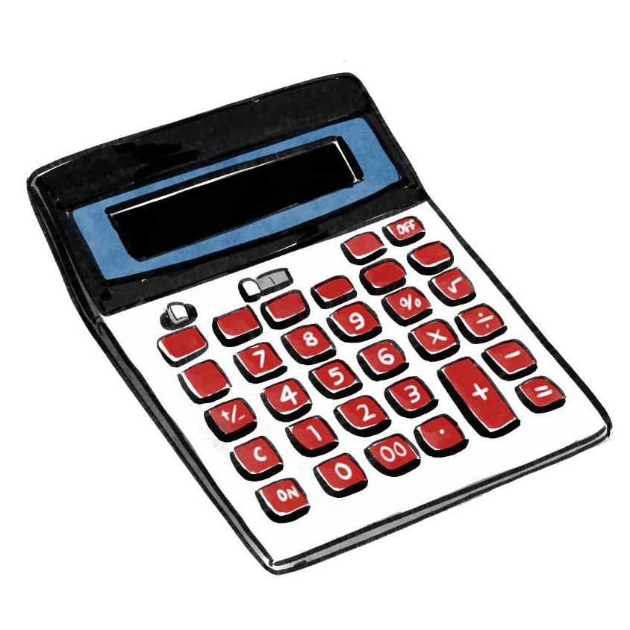
Rule 5.1a - Calculating a Score Differential
A lower score may not always produce a lower score differential.
This is dependent on the Course Rating and Slope Rating.
Therefore, a higher score on a harder course may result in a lower score differential than a lower score on an easier course.
(95 – 71.5) x (113 ÷ 125) = 21.2
(97 – 73.8) x (113 ÷ 140) = 18.7
Notes:
It is important to note that a lower score does not always equate to a lower score differential.

Slide 53
Rule 5.1a - Basic Calculation of an 18-hole Score Differential
=
x
(par + Course Handicap – (points scored – 36) – Course Rating)
Score Differential
(113 ÷ Slope Rating)
Examples:
A player with a Course Handicap of 28 scores 33 points on a course with a par of 71, a Course Rating of 71.5 and Slope Rating of 125. The player’s Score Differential is:
(113 ÷ 125)
0.904
x
(71 + 28 – (33 – 36) - 71.5)
30.5
=
Score Differential
27.6
A player with a Course Handicap of 28 scores 30 points on a course with a par of 72, a Course Rating of 73.8 and Slope Rating of 140. The player’s Score Differential is:
(113 ÷ 140)
0.807
x
(72 + 28 – (30 – 36) - 73.8)
32.2
=
Score Differential
26.0
Notes:
Here are a couple of examples using Stableford points.

Slide 54


Rule 5.1b - 9-hole Scores
The calculation of a Handicap Index relies on 18-hole Score Differentials
Therefore, 9-hole scores need to be converted into an 18-hole Score Differential before they can be used.
This is done by scaling up the 9-hole score using net par (plus one additional stroke on the first hole not played) – or adding 17 Stableford points.
The second 9 holes used for scaling up is always the same 9 holes that were played.

Slide 55

Rule 5.2 - Calculating a Handicap Index
Key Terminology
 | Scoring Record | A history of a player’s last 20 acceptable scores – including: the date the round was played, the Course Rating and Slope Rating of the tees played, the player’s score, and the score differential.
Notes:
A player’s score differentials sit within their scoring record. The scoring record is basically a historical log of the player’s playing activity – including all of the relevant information about each round

Slide 56
Rule 5.2 - Calculation of a Handicap Index
For Fewer Than 20 Scores
Number of Score Differentials in scoring record | Score Differential(s) to be used in calculation of Handicap Index | Adjustment
1 | Score Differential | -2.0
2 | Lowest 1 | -2.0
3 | Lowest 1 | -2.0
4 | Lowest 1 | -1.0
5 | Lowest 1 | 0
6 | Average of lowest 2 | -1.0
7 or 8 | Average of lowest 2 | 0
9 to 11 | Average of lowest 3 | 0
12 to 14 | Average of lowest 4 | 0
15 or 16 | Average of lowest 5 | 0
17 or 18 | Average of lowest 6 | 0
19 | Average of lowest 7 | 0
20 | Average of lowest 8 | 0
Notes:
A fully established scoring record is one which contains at least 20 scores and a Handicap Index is calculated from the best score differentials within that scoring record.
If a scoring record contains fewer than 20 score differentials, we use this table to determine the number of score differentials to be included in the calculation and any adjustment that may apply.
We have already learnt that a player needs to have completed a minimum of only 9 holes in order to obtain a Handicap Index, which would be scaled up to an 18-hole score for the purpose of calculating an equivalent 18-hole Score Differential.
The allocated Handicap Index is based that initial Score Differential, minus 2
Our research showed that, on balance, players new to the game are better than their initial Handicap Index suggests.
This was based on predictions as to what their next score would be.
Therefore, in order to protect the field – the lowest Score Differential is reduced by a further two strokes.
The other point to make here is that while we do permit a Handicap Index to be issued on the basis of only 9 holes – that isn’t much evidence upon which to base an initial Handicap Index. With only 1 9-hole score, we don’t have a solid picture of what the golfer looks like. So, the system errs on the side of caution – for the sake of the field.
The magnitude of the adjustment diminishes as more scores are submitted – however, when we get to 6 scores and we start to introduce the concept of averaging – we do reintroduce a -1 adjustment.
When we get to 7 scores – we use the average of the best two – with no adjustment…. And so on….

Slide 57
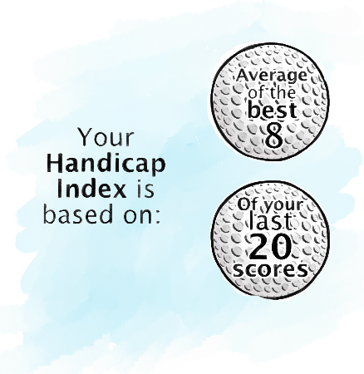
Rule 5.2 - Calculation of a Handicap Index
For 20 Scores
Average the lowest 8 of the most recent 20 score differentials, rounded to the nearest tenth.
Notes:
When a scoring record contains 20 or more score differentials, the procedure for calculating a Handicap Index is to average the best 8 out of the most recent 20 score differentials.
This number is rounded to the nearest tenth.

Slide 58
Example of a Scoring Record
Score No. | Date Played | Course | Course Rating | Slope Rating | Adjusted Gross Score | Score Differential
1 | 22/9/20 | Hill GC | 70.5 | 125 | 91 | 18.5
2 | 5/9/20 | Hill GC | 70.5 | 125 | 92 | 19.4
3 | 1/9/20 | Hill GC | 70.5 | 125 | 99 | 25.8
4 | 28/8/20 | Hill GC | 70.5 | 125 | 89 | 16.7
5 | 23/8/20 | River GC | 71.3 | 127 | 92 | 18.4
6 | 26/7/20 | Meadow GC | 72.2 | 131 | 87 | 12.8
7 | 14/7/20 | Hill GC | 70.5 | 125 | 97 | 24.0
8 | 4/7/20 | Hill GC | 70.5 | 125 | 88 | 15.8
9 | 19/6/20 | River GC | 71.3 | 127 | 87 | 13.5
10 | 16/6/20 | Valley GC | 69.9 | 118 | 95 | 24.0
11 | 12/6/20 | Forest GC | 70.1 | 115 | 86 | 15.6
12 | 5/6/20 | Meadow GC | 72.2 | 131 | 85 | 11.0
13 | 2/6/20 | Hill GC | 70.5 | 125 | 82 | 10.4
14 | 30/5/20 | Hill GC | 70.5 | 125 | 94 | 21.2
15 | 25/5/20 | Valley GC | 69.9 | 118 | 89 | 18.3
16 | 22/5/20 | Hill GC | 70.5 | 125 | 97 | 24.0
17 | 29/4/20 | Hill GC | 70.5 | 125 | 85 | 13.1
18 | 14/4/20 | Hill GC | 70.5 | 125 | 93 | 20.3
19 | 10/4/20 | Hill GC | 70.5 | 125 | 94 | 21.2
20 | 3/4/20 | Meadow GC | 72.2 | 131 | 86 | 12.1
21
Notes:
This is an example of a fully established 20 score record.

Slide 59
Example of 8 of 20 Calculation
Score No. | Date Played | Course | Course Rating | Slope Rating | Adjusted Gross Score | Score Differential
1 | 22/9/20 | Hill GC | 70.5 | 125 | 91 | 18.5
2 | 5/9/20 | Hill GC | 70.5 | 125 | 92 | 19.4
3 | 1/9/20 | Hill GC | 70.5 | 125 | 99 | 25.8
4 | 28/8/20 | Hill GC | 70.5 | 125 | 89 | 16.7
5 | 23/8/20 | River GC | 71.3 | 127 | 92 | 18.4
6 | 26/7/20 | Meadow GC | 72.2 | 131 | 87 | 12.8
7 | 14/7/20 | Hill GC | 70.5 | 125 | 97 | 24.0
8 | 4/7/20 | Hill GC | 70.5 | 125 | 88 | 15.8
9 | 19/6/20 | River GC | 71.3 | 127 | 87 | 13.5
10 | 16/6/20 | Valley GC | 69.9 | 118 | 95 | 24.0
11 | 12/6/20 | Forest GC | 70.1 | 115 | 86 | 15.6
12 | 5/6/20 | Meadow GC | 72.2 | 131 | 85 | 11.0
13 | 2/6/20 | Hill GC | 70.5 | 125 | 82 | 10.4
14 | 30/5/20 | Hill GC | 70.5 | 125 | 94 | 21.2
15 | 25/5/20 | Valley GC | 69.9 | 118 | 89 | 18.3
16 | 22/5/20 | Hill GC | 70.5 | 125 | 97 | 24.0
17 | 29/4/20 | Hill GC | 70.5 | 125 | 85 | 13.1
18 | 14/4/20 | Hill GC | 70.5 | 125 | 93 | 20.3
19 | 10/4/20 | Hill GC | 70.5 | 125 | 94 | 21.2
20 | 3/4/20 | Meadow GC | 72.2 | 131 | 86 | 12.1
21
Notes:
To calculate the player’s Handicap Index, we must first identify the best 8 score differentials – as highlighted here in yellow.

Slide 60
Score No. | Date Played | Course | Course Rating | Slope Rating | Adjusted Gross Score | Score Differential
1 | 22/9/20 | Hill GC | 70.5 | 125 | 91 | 18.5
2 | 5/9/20 | Hill GC | 70.5 | 125 | 92 | 19.4
3 | 1/9/20 | Hill GC | 70.5 | 125 | 99 | 25.8
4 | 28/8/20 | Hill GC | 70.5 | 125 | 89 | 16.7
5 | 23/8/20 | River GC | 71.3 | 127 | 92 | 18.4
6 | 26/7/20 | Meadow GC | 72.2 | 131 | 87 | 12.8
7 | 14/7/20 | Hill GC | 70.5 | 125 | 97 | 24.0
8 | 4/7/20 | Hill GC | 70.5 | 125 | 88 | 15.8
9 | 19/6/20 | River GC | 71.3 | 127 | 87 | 13.5
10 | 16/6/20 | Valley GC | 69.9 | 118 | 95 | 24.0
11 | 12/6/20 | Forest GC | 70.1 | 115 | 86 | 15.6
12 | 5/6/20 | Meadow GC | 72.2 | 131 | 85 | 11.0
13 | 2/6/20 | Hill GC | 70.5 | 125 | 82 | 10.4
14 | 30/5/20 | Hill GC | 70.5 | 125 | 94 | 21.2
15 | 25/5/20 | Valley GC | 69.9 | 118 | 89 | 18.3
16 | 22/5/20 | Hill GC | 70.5 | 125 | 97 | 24.0
17 | 29/4/20 | Hill GC | 70.5 | 125 | 85 | 13.1
18 | 14/4/20 | Hill GC | 70.5 | 125 | 93 | 20.3
19 | 10/4/20 | Hill GC | 70.5 | 125 | 94 | 21.2
20 | 3/4/20 | Meadow GC | 72.2 | 131 | 86 | 12.1
21
 | 12.8
+ | 15.8
+ | 13.5
+ | 15.6
+ | 11.0
+ | 10.4
+ | 13.1
+ | 12.1
= | 104.3 | / | 8
Adding together the best 8 differentials out of the last 20:
And averaging the total:
Handicap Index of 13.0
Notes:
These 8 score differentials are added up and divided by 8 – giving a Handicap Index of 13.0.

Slide 61
Score No. | Date Played | Course | Course Rating | Slope Rating | Adjusted Gross Score | Score Differential
1 | 25/9/20 | Meadow GC | 72.2 | 131 | 89 | 14.5
2 | 22/9/20 | Hill GC | 70.5 | 125 | 91 | 18.5
3 | 5/9/20 | Hill GC | 70.5 | 125 | 92 | 19.4
4 | 1/9/20 | Hill GC | 70.5 | 125 | 99 | 25.8
5 | 28/8/20 | Hill GC | 70.5 | 125 | 89 | 16.7
6 | 23/8/20 | River GC | 71.3 | 127 | 92 | 18.4
7 | 26/7/20 | Meadow GC | 72.2 | 131 | 87 | 12.8
8 | 14/7/20 | Hill GC | 70.5 | 125 | 97 | 24.0
9 | 4/7/20 | Hill GC | 70.5 | 125 | 88 | 15.8
10 | 19/6/20 | River GC | 71.3 | 127 | 87 | 13.5
11 | 16/6/20 | Valley GC | 69.9 | 118 | 95 | 24.0
12 | 12/6/20 | Forest GC | 70.1 | 115 | 86 | 15.6
13 | 5/6/20 | Meadow GC | 72.2 | 131 | 85 | 11.0
14 | 2/6/20 | Hill GC | 70.5 | 125 | 82 | 10.4
15 | 30/5/20 | Hill GC | 70.5 | 125 | 94 | 21.2
16 | 25/5/20 | Valley GC | 69.9 | 118 | 89 | 18.3
17 | 22/5/20 | Hill GC | 70.5 | 125 | 97 | 24.0
18 | 29/4/20 | Hill GC | 70.5 | 125 | 85 | 13.1
19 | 14/4/20 | Hill GC | 70.5 | 125 | 93 | 20.3
20 | 10/4/20 | Hill GC | 70.5 | 125 | 94 | 21.2
21 | 3/4/20 | Meadow GC | 72.2 | 131 | 86 | 12.1
 | 14.5
+ | 12.8
+ | 15.8
+ | 13.5
+ | 15.6
+ | 11.0
+ | 10.4
+ | 13.1
= | 106.7 | ÷ | 8
Adding together the best 8 differentials out of the last 20:
And averaging the total:
Handicap Index of 13.3
Notes:
The process of calculating the updated Handicap Index is then repeated:
The best 8 score differentials are identified, added up and divided by 8
In this case, the updated Handicap Index is 13.3
This makes sense because 12.1 has been replaced by 14.5

Slide 62
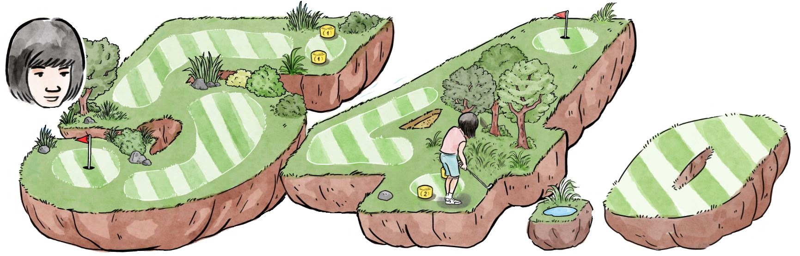
Rule 5.3 - Maximum Handicap Index
Regardless of age or gender
Notes:
The maximum Handicap Index that can be allocated to a golfer is 54.0 – regardless of age or gender.
This speaks to one of the key principles of the World Handicap System.
To be as inclusive and welcoming as possible.
To make it as easy as possible for golfers to obtain and maintain a Handicap Index.
There are high handicap golfers on golf courses today.
Providing these golfers with the Handicap Index they truly need will help them:
Better track their progress.
Stay motivated.
Have more fun.
Keep playing.

Slide 63



Rule 5.7 - Memory of the Low Handicap Index
Key Terminology
 | Low Handicap Index | The lowest Handicap Index achieved by a player during the 12-month period preceding the most recent score on their scoring record
 | Cap | The procedure that reduces or limits the amount by which a player’s Handicap Index can increase - when measured against the player’s Low Handicap Index.
Notes:
The Low Handicap Index represents the demonstrated ability of a player over the 12-month period preceding the most recent score in the player’s scoring record and provides a reference point against which the current Handicap Index can be compared.

Slide 64

Rule 5.7 - Memory of Low Handicap Index
Low
Handicap
Index
A player’s Low Handicap Index is remembered within the handicap formula
It provides a reference point against which the current Handicap Index can be compared
This is to help ensure that the player’s current Handicap Index cannot stray too far away from their demonstrated ability, in too short a space of time
If the new Index is more than a certain number of strokes above the Low Handicap Index, the cap is triggered.
Notes:
If the Handicap Formula were only based on the calculation of the best 8 of their last 20 scores – there would be no memory of a player’s performance or ability beyond those last 20 scores.
Think of a golfer who is a regular player and a frequent submitter of scores. Without memory, on paper, this player could potentially be a very different player in a short space of time – for example, if they are experiencing a poor run of form. Over the course of a 20 score cycle – all of their good scores would start to wash out of their scoring record – and their Handicap Index would be based on higher scores – which would not be truly reflective of their demonstrated ability.
A golfer’s ability doesn’t normally change very quickly. And the player’s true demonstrated ability could return at any moment – with a few lessons, or a holiday – at which point they would be holding a Handicap Index which is too high.
The Cap is a safeguard within the WHS to manage such situations.

Slide 65
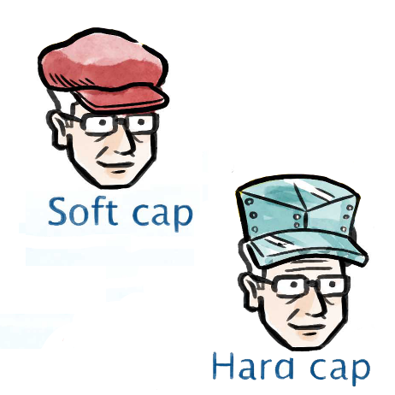
Rule 5.8 - Limit on Upward Movement of Handicap Index
The cap comes in two forms:
The soft cap suppresses upward movement
The hard cap prevents further upward movement
Notes:
The soft cap and hard cap will be implemented to ensure that a temporary loss of form does not cause a player’s Handicap Index to move too far from a level consistent with their demonstrated ability. The caps also serve as anti-abuse mechanism and will aid in minimizing the potential for handicap manipulation. The Handicap Committee at the club will still play a key role and have the ability to allow a player’s Index to exceed the hard cap if special circumstances such as an injury exist.
Key points here:
This favours the consistent player. The volatile player will be impacted more often, which is a good feature for a handicap system to have.
A temporary loss of form should not cause a player’s Handicap Index to move too far from a level which is consistent with their underlying potential.
A low Handicap Index (or anchor) is part of the system and should be made visible to the player on their scoring record.

Slide 66
Rule 5.8 - Limit on Upward Movement of Handicap Index
The soft cap suppresses upward movement when the difference between the new calculated Index and the Low Index is greater than 3.0.
The increase is suppressed by 50% of any value over 3.0.
The hard cap prevents further upward movement by placing a hard ceiling at 5.0 above the Low Index.
The soft cap and hard cap procedures only start to take effect once a player has at least 20 acceptable scores in their scoring record.

Slide 67
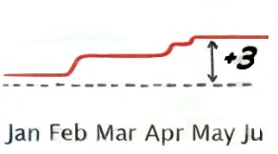

Rule 5.8 - Soft Cap Examples
Player submits a new score:
 |  | Consider Soft Cap |  |  |  |  | Consider Hard Cap
New calculated HI (8 / 20) | Low Index (LI) | 8/20 - LI | ≤ 3.0 | > 3.0 | 50% of value > 3.0 (Suppression) | ≤ 3 + Suppression | Movement compared to LI | > 5 | New HI
14.0 | 12.0 | 2.0 | 2.0 | 0 | 0 | 2.0 + 0 | 2.0 | 0 | 14.0
15.0 | 12.0 | 3.0 | 3.0 | 0 | 0 | 3.0 + 0 | 3.0 | 0 | 15.0
19.0 | 12.0 | 7.0 | 3.0 | 4.0 | 2.0 | 3.0 + 2.0 | 5.0 | 0 | 17.0
Notes:
Player submits a new score and the 8/20 averaging calculation suggests that the player’s new HI should be 19.0.
The system then compares this number to the lowest HI the player has achieved in the 12 months preceding their last score.
In this case – the difference is 7.0 – which is greater than 3.0 by 4.0 strokes.
This means that the player has left the tarmac and is in the gravel – so the soft cap kicks in. The suppression element only applies to anything over 3.0. And 50% of 4.0 is 2.0.
This means that the 7.0 increase calculated by the 8/20 average is suppressed by 2.0 – to make it a 5.0 stroke increase. The new HI is 17.0.

Slide 68
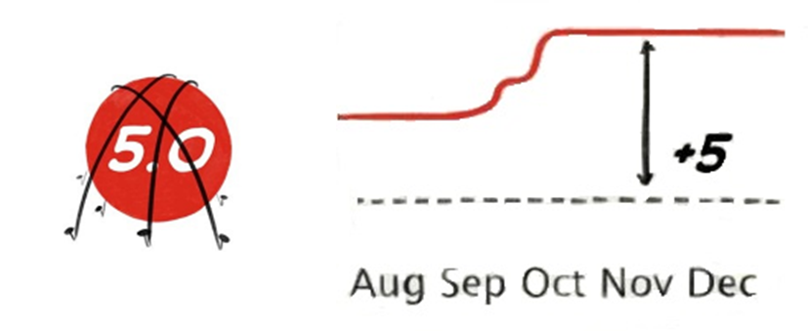
Rule 5.8 - Hard Cap Example
Player submits a new score:
 |  | Consider Soft Cap |  |  |  |  | Consider Hard Cap
New calculated HI (8 / 20) | Low Index (LI) | 8/20 - LI | ≤ 3.0 | > 3.0 | 50% of value > 3.0 (Suppression) | ≤ 3 + Suppression | Movement compared to LI | > 5 | New HI
14.0 | 12.0 | 2.0 | 2.0 | 0 | 0 | 2.0 + 0 | 2.0 | 0 | 14.0
15.0 | 12.0 | 3.0 | 3.0 | 0 | 0 | 3.0 + 0 | 3.0 | 0 | 15.0
19.0 | 12.0 | 7.0 | 3.0 | 4.0 | 2.0 | 3.0 + 2.0 | 5.0 | 0 | 17.0
20.0 | 12.0 | 8.0 | 3.0 | 5.0 | 2.5 | 3.0 + 2.5 | 5.5 | 0.5 | 17.0
Notes:
Player submits a new score and the 8/20 averaging calculation suggests that the player’s new HI should be 20.0.
The system then compares this number to the lowest HI the player has achieved in the 12 months preceding their last score.
In this case – the difference is 8.0 – which is greater than 3.0 by 5.0 strokes.
This means that the player has left the tarmac and is in the gravel – so the soft cap kicks in. The suppression element only applies to anything over 3.0. And 50% of 5.0 is 2.5.
This means that the 8.0 increase calculated by the 8/20 average is suppressed by 2.5 – to make it a 5.5 stroke increase. However, 5.5 is more than 5.0 (the hard cap). So, the new HI is capped at 17.0.

Slide 69
Rule 5.9 - Exceptional Scores
A score differential which is at least 7.0 strokes or more better than the player’s Handicap Index at the time the round was played.
Must be an acceptable score from any format of play,
competitive or general play.
When a player submits an exceptional score, the handicap
formula applies an additional adjustment to the player’s
updated Handicap Index – according to the table.
This adjustment is in addition to any reduction caused
within the 8/20 calculation.
The Handicap Committee can override the adjustment
Score Relative to Index | -7.0 | -10.0
Extra adjustment | -1.0 | -2.0
Notes:
7.0 to 9.9 better than the current Handicap Index = -1.0 additional adjustment for an exceptional score
10.0 or more better than the current Handicap Index = -2.0 additional adjustment for an exceptional score

Slide 70
Score No. | Date Played | Course | Course Rating | Slope Rating | Adjusted Gross Score | Score Differential
1 | 25/9/20 | Meadow GC | 72.2 | 131 | 89 | 14.5
2 | 22/9/20 | Hill GC | 70.5 | 125 | 91 | 18.5
3 | 5/9/20 | Hill GC | 70.5 | 125 | 92 | 19.4
4 | 1/9/20 | Hill GC | 70.5 | 125 | 99 | 25.8
5 | 28/8/20 | Hill GC | 70.5 | 125 | 89 | 16.7
6 | 23/8/20 | River GC | 71.3 | 127 | 92 | 18.4
7 | 26/7/20 | Meadow GC | 72.2 | 131 | 87 | 12.8
8 | 14/7/20 | Hill GC | 70.5 | 125 | 97 | 24.0
9 | 4/7/20 | Hill GC | 70.5 | 125 | 88 | 15.8
10 | 19/6/20 | River GC | 71.3 | 127 | 87 | 13.5
11 | 16/6/20 | Valley GC | 69.9 | 118 | 95 | 24.0
12 | 12/6/20 | Forest GC | 70.1 | 115 | 86 | 15.6
13 | 5/6/20 | Meadow GC | 72.2 | 131 | 85 | 11.0
14 | 2/6/20 | Hill GC | 70.5 | 125 | 82 | 10.4
15 | 30/5/20 | Hill GC | 70.5 | 125 | 94 | 21.2
16 | 25/5/20 | Valley GC | 69.9 | 118 | 89 | 18.3
17 | 22/5/20 | Hill GC | 70.5 | 125 | 97 | 24.0
18 | 29/4/20 | Hill GC | 70.5 | 125 | 85 | 13.1
19 | 14/4/20 | Hill GC | 70.5 | 125 | 93 | 20.3
20 | 10/4/20 | Hill GC | 70.5 | 125 | 94 | 21.2
21 | 3/4/20 | Meadow GC | 72.2 | 131 | 86 | 12.1
Rule 5.9 - Application of an
Exceptional Score Reduction
Handicap Index = 13.3

Slide 71
Score No. | Date Played | Course | Course Rating | Slope Rating | Adjusted Gross Score | Score Differential
1
2 | 25/9/20 | Meadow GC | 72.2 | 131 | 89 | 14.5
3 | 22/9/20 | Hill GC | 70.5 | 125 | 91 | 18.5
4 | 5/9/20 | Hill GC | 70.5 | 125 | 92 | 19.4
5 | 1/9/20 | Hill GC | 70.5 | 125 | 99 | 25.8
6 | 28/8/20 | Hill GC | 70.5 | 125 | 89 | 16.7
7 | 23/8/20 | River GC | 71.3 | 127 | 92 | 18.4
8 | 26/7/20 | Meadow GC | 72.2 | 131 | 87 | 12.8
9 | 14/7/20 | Hill GC | 70.5 | 125 | 97 | 24.0
10 | 4/7/20 | Hill GC | 70.5 | 125 | 88 | 15.8
11 | 19/6/20 | River GC | 71.3 | 127 | 87 | 13.5
12 | 16/6/20 | Valley GC | 69.9 | 118 | 95 | 24.0
13 | 12/6/20 | Forest GC | 70.1 | 115 | 86 | 15.6
14 | 5/6/20 | Meadow GC | 72.2 | 131 | 85 | 11.0
15 | 2/6/20 | Hill GC | 70.5 | 125 | 82 | 10.4
16 | 30/5/20 | Hill GC | 70.5 | 125 | 94 | 21.2
17 | 25/5/20 | Valley GC | 69.9 | 118 | 89 | 18.3
18 | 22/5/20 | Hill GC | 70.5 | 125 | 97 | 24.0
19 | 29/4/20 | Hill GC | 70.5 | 125 | 85 | 13.1
20 | 14/4/20 | Hill GC | 70.5 | 125 | 93 | 20.3
21 | 10/4/20 | Hill GC | 70.5 | 125 | 94 | 21.2
Rule 5.9 - Application of an
Exceptional Score Reduction
1 | 1/10/20 | Hill GC | 70.5 | 125 | 75 | 4.1
Handicap Index = 13.3
A score differential of 4.1 is submitted which is 9.2 strokes better than current Handicap Index; an exceptional score
The newly calculated Handicap Index is 11.9
With the additional adjustment of -1.0, the new Handicap Index is 10.9

Slide 72
Score No. | Date Played | Course | Course Rating | Slope Rating | Adjusted Gross Score | Score Differential
1 | 1/11/20 | Hill GC | 70.5 | 125 | 88 | 15.8
2 | 25/10/20 | Meadow GC | 72.2 | 131 | 89 | 15.7
3 | 22/10/20 | Hill GC | 70.5 | 125 | 89 | 16.7
4 | 5/10/20 | River GC | 71.3 | 127 | 87 | 14.9
5 | 1/10/20 | Hill GC | 70.5 | 125 | 75 | 4.1
6 | 25/9/20 | Meadow GC | 72.2 | 131 | 89 | 14.5
7 | 22/9/20 | Hill GC | 70.5 | 125 | 91 | 18.5
8 | 5/9/20 | Hill GC | 70.5 | 125 | 92 | 19.4
9 | 1/9/20 | Hill GC | 70.5 | 125 | 99 | 25.8
10 | 28/8/20 | Hill GC | 70.5 | 125 | 89 | 16.7
11 | 23/8/20 | River GC | 71.3 | 127 | 92 | 18.4
12 | 26/7/20 | Meadow GC | 72.2 | 131 | 87 | 12.8
13 | 14/7/20 | Hill GC | 70.5 | 125 | 97 | 24.0
14 | 4/7/20 | Hill GC | 70.5 | 125 | 88 | 15.8
15 | 19/6/20 | River GC | 71.3 | 127 | 87 | 13.5
16 | 16/6/20 | Valley GC | 69.9 | 118 | 95 | 24.0
17 | 12/6/20 | Forest GC | 70.1 | 115 | 86 | 15.6
18 | 5/6/20 | Meadow GC | 72.2 | 131 | 85 | 11.0
19 | 2/6/20 | Hill GC | 70.5 | 125 | 82 | 10.4
20 | 30/5/20 | Hill GC | 70.5 | 125 | 94 | 21.2
21 | 25/5/20 | Valley GC | 69.9 | 118 | 89 | 18.3
Adj
-1
-1
-1
-1
-1
-1
-1
-1
-1
-1
-1
-1
-1
-1
-1
-1
-1
Rule 5.9 - Application of an
Exceptional Score Reduction
The adjustment is made by adding a -1 adjustment to all 20 score differentials within the player’s scoring record
This helps to retain the impact of the adjustment after the next score is submitted.
As the adjustment is not added to subsequent scores, it gradually washes out of the scoring record naturally
After 4 more scores have been submitted, this player’s Handicap Index has nudged back up to 11.2

Slide 73
Rule 5.9 - Application of an
Exceptional Score Reduction
Another Score Differential of 4.1 is submitted, which is 7.2 better than the player’s 11.2 Handicap Index
This leads to a further -1 adjustment to all 20 previous score differentials, which can overlap with previous adjustments
So, the effect of multiple exceptional scores is cumulative
The new Handicap Index in this case is now 8.9

Slide 74
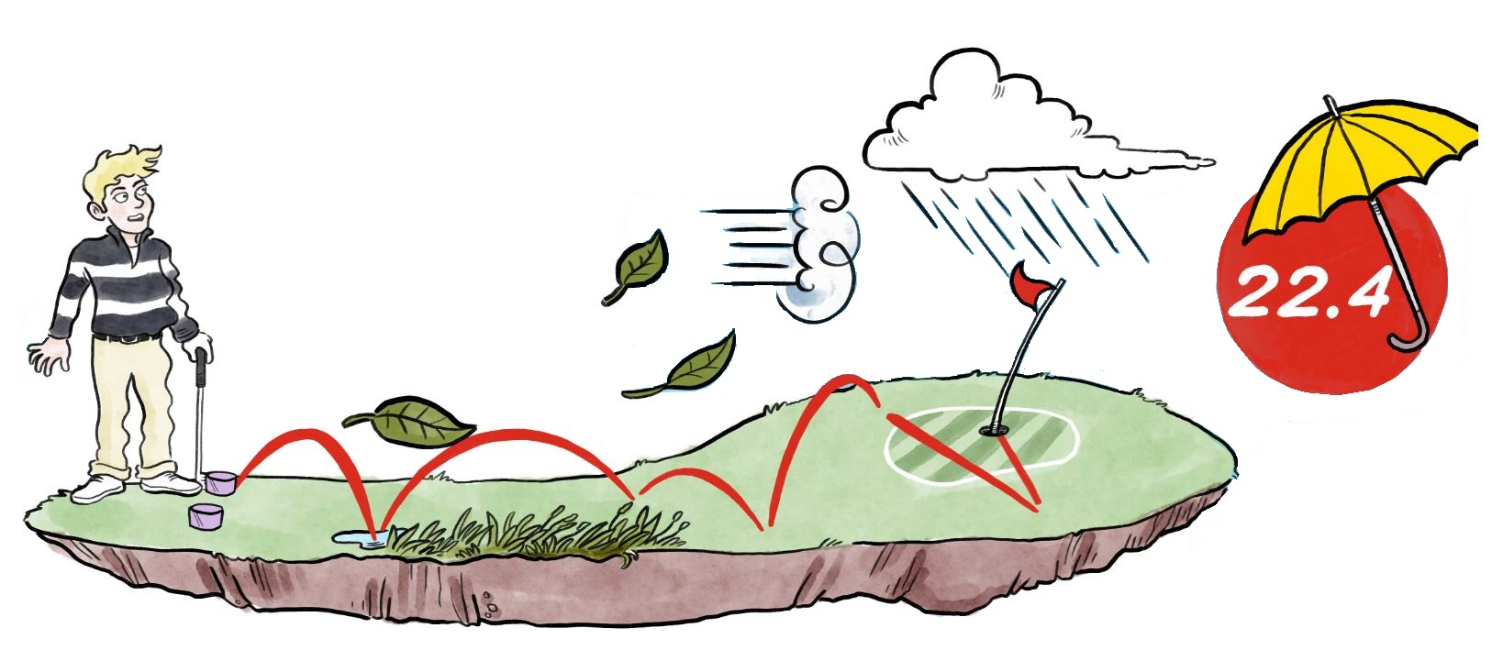
Rule 5.6 - Playing Conditions Calculation
PCC is the renamed CBA.
Abnormal playing conditions can be caused by weather and/or course set-up.
The PCC assesses whether playing conditions on the day were ‘normal’ or significantly harder or easier than normal.
Notes:
The short rationale for introducing this feature to the WHS – golf is an outdoor sport.
A score of 80 on a rainy, windy day or on a day where the course is set up more difficult than normal may be more impressive than a 79 on a calm day with normal course conditions – so the WHS will account for this.
The calculation will be automatic through the computation service provided through the National Association, and any adjustment will be applied directly to the golfer’s score differential (not their score)
Similar features to PCC already work well in certain parts of the world.

Slide 75
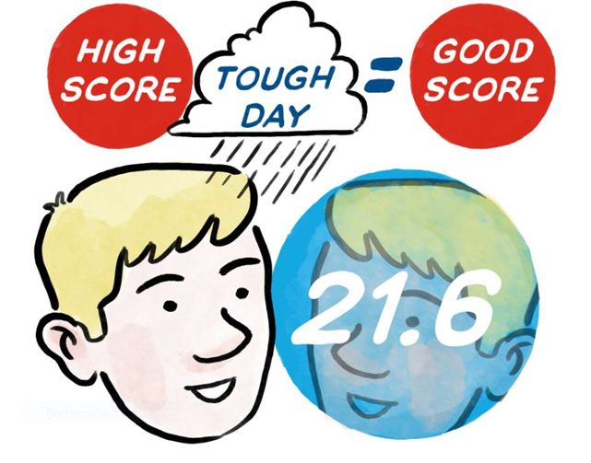
Rule 5.6 - Playing Conditions Calculation
When abnormal playing conditions cause scores to be higher or lower than expected on a given day, a Playing Conditions Calculation will adjust score differentials to better reflect the player’s actual performance.
This means that a higher score on a tough day may still be a good score and one of your best 8, used to calculate your updated Handicap Index.
Notes:
The playing conditions calculation determines whether playing conditions on the day differed from normal conditions to the extent that an adjustment is needed to compensate.
It is a daily statistical procedure that compares the scores submitted by players on the day are in line with expected scoring patterns.
The purpose of this feature within the handicap calculation is to recognize that an average score submitted in harder playing conditions may be better than a good score submitted in easier playing conditions.
Unadjusted, such a score may be automatically omitted from the Handicap Index calculation despite being a good score.

Slide 76
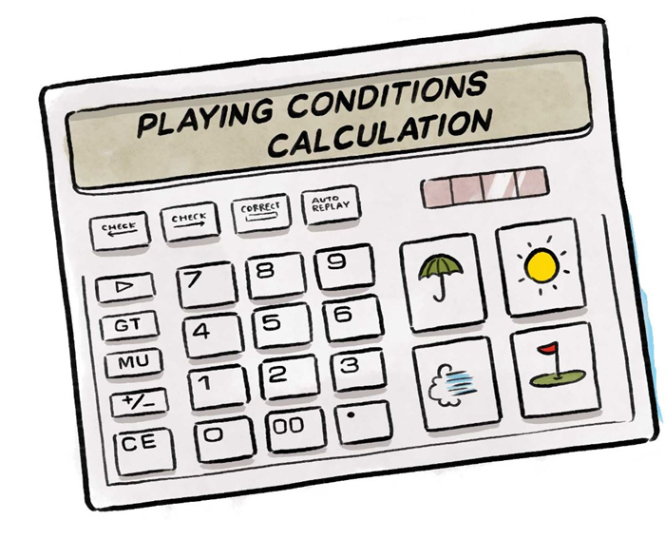
Rule 5.6 - Playing Conditions Calculation (PCC)
The PCC: Is generally performed only once for a day Considers all acceptable scores submitted on a golf course (all formats, competitive & recreational, 9 & 18 holes) Requires at least eight acceptable scores submitted by players with a Handicap Index of 36.0 or below Is automatically applied within the calculation of score differentials for all players Is designed to be simple and conservative in nature, adjusting score differentials in integer values ranging from -1 to +3
Notes:
The PCC can also be used to indicate when the Course Rating of a golf course may need to be reviewed.
If the PCC adjustment (which is conservative) is being applied 4-5 days a week, the ratings may not be accurately reflecting the difficulty of the golf course, often due to issues with course setup.

Slide 77
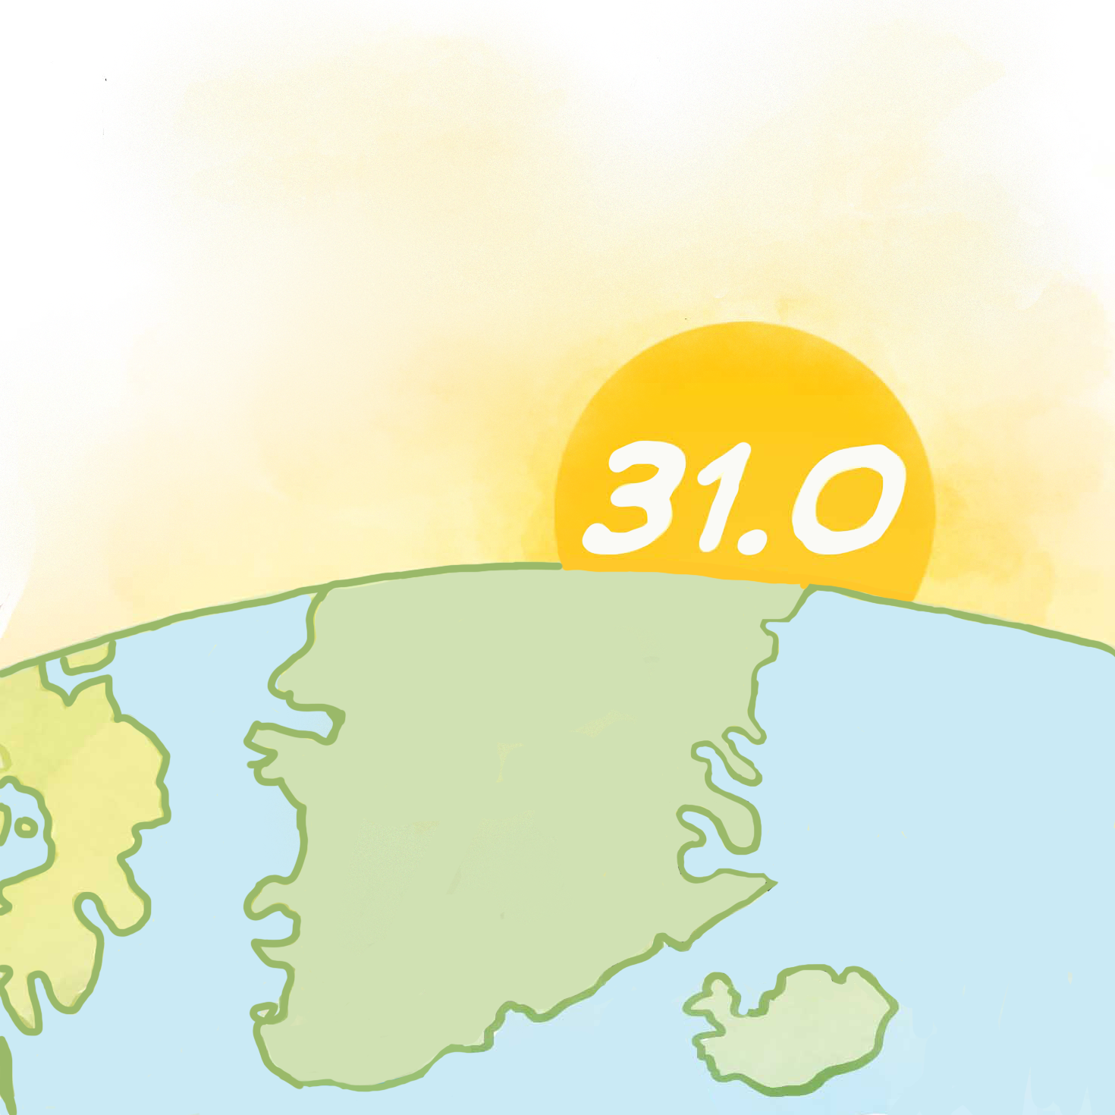
Rule 5.4 - Prompt Revision of Handicap Index
Players should submit their scores as soon as possible after the round is completed, and before midnight.
This is to ensure the score will be used for the Playing Conditions Calculation.
A player’s Handicap Index will then be updated the day after a score was submitted.
If more than one score is posted in a single day, the Handicap Index would not normally be updated until the next day.
Notes:
A revision will take place whenever a player posts a score.
Golfers should be encouraged submit their scores as soon as possible following their round(s) – which will allow their scores to be included within the Playing Conditions Calculation.

Slide 78
RECAP:
Rule 5.1a - Basic Calculation of an 18-hole Score Differential
In stroke play formats (gross score, net score or Maximum Score), where scores are returned as hole-by-hole or adjusted gross score:
In Stableford and Par/Bogey formats, where scores are returned as points relative to par:
x
(113 ÷ Slope Rating)
(Adjusted gross score – Course Rating)
x
(par + Course Handicap – (points scored – 36) – Course Rating
(113 ÷ Slope Rating)

Slide 79
Rule 5.1a - Calculation of an 18-hole Score Differential with PCC
In stroke play formats (gross score, net score or Maximum Score), where scores are returned as hole-by-hole or adjusted gross score:
In Stableford and Par/Bogey formats, where scores are returned as points relative to par:
x
(113 ÷ Slope Rating)
(Adjusted gross score – Course Rating – PCC adjustment)
x
(par + Course Handicap – (points scored – 36) – Course Rating – PCC adjustment
(113 ÷ Slope Rating)

Slide 80
Rule 5.1a - Calculation of an 18-hole Score Differential with PCC
x
(113 ÷ Slope Rating)
(Adjusted gross score – Course Rating – PCC adjustment)
Examples:
A player’s adjusted gross score is 95 on a course with Course Rating of 71.5, a Slope Rating of 125.
The PCC for the day calculates at +1. The player’s score differential is:
(113 ÷ 125)
0.904
x
(95 – 71.5 –
(23.5 –
- PCC)
- (+1))
=
Score Differential
20.3
A player’s adjusted gross score is 97 on a course with Course Rating of 73.8 and Slope Rating of 140.
The PCC for the day calculates at -1. The player’s score differential is:
(113 ÷ 140)
0.807
x
(97 – 73.8 –
(23.2 –
- PCC)
- (-1)
=
Score Differential
19.5

Slide 81
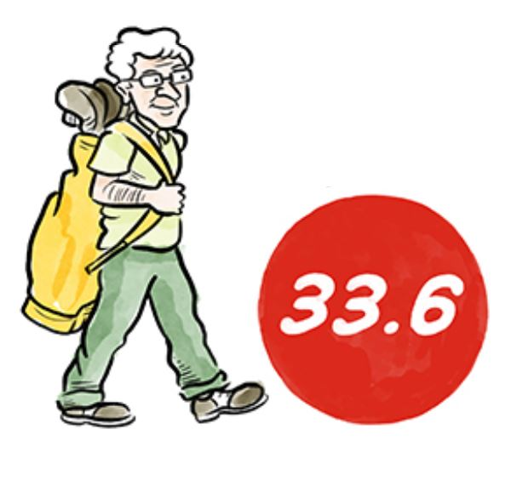
Impact on Player’s Handicap Index
Basic calculation of best 8 of last 20 scores.
Slope Rating adjustment to Course & Playing Handicap.
Incremental increases not restricted to 0.1, but Cap mechanism restricts upward movement over a period of time.
PCC – robust, but conservative mechanism.
Exceptional scores lead to immediate reduction; can be triggered by one score.
Net double bogey – maximum hole score for handicap purposes.

Slide 82



Rule 7 - Committee Actions
Principle of the Rule:
The Handicap Committee plays a vital role in the successful administration of a player’s Handicap Index and is equipped with tools to intervene when the calculated Handicap Index is no longer reflective of the player’s golfing ability.
Used appropriately, these tools are designed to ensure that players are treated fairly and consistently from golf club to golf club.
The Committee in charge of the competition also plays an important role in setting appropriate Terms of the Competition for all participating players.
7.0

Slide 83
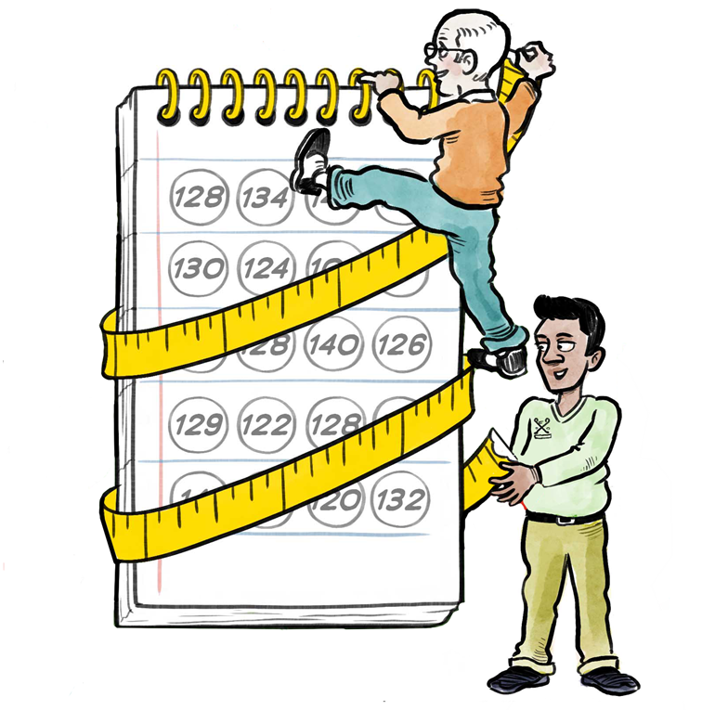
Rule 7 - Calculating a Handicap Index
Key Terminology
Handicap Committee | The entity established by a golf club or an Authorized Association which is responsible for ensuring compliance with the obligations of the golf club or Authorized Association under the Rules of Handicapping
Handicap Review | A procedure carried out by the Handicap Committee to determine whether a player’s Handicap Index needs to be adjusted.
Home Club | A player’s primary golf club designated by the player to ensure their Handicap Index is managed in accordance with the Rules of Handicapping.

Slide 84
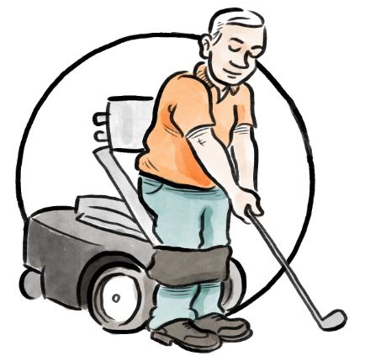
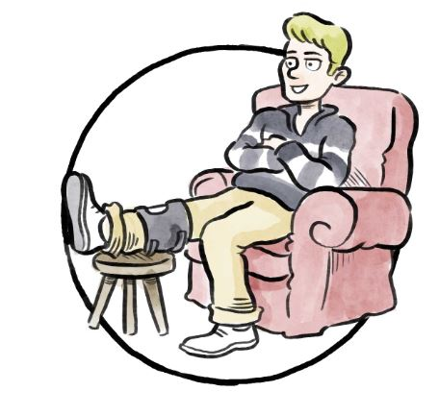
Rule 7.1a - Conducting a Handicap Review
It is strongly recommended that the Handicap Committee conducts a handicap review at least once a year, for all players for which it is responsible.
WHS compliant software - DataGolf - will recommend reports and give notifications to assist Handicap Committees identify those players requiring a handicap review.
A player can request a handicap review, if they believe their Handicap Index no longer reflects their demonstrated ability.
A player must be made aware of, and be involved in, the handicap review process and be able to appeal a decision.
Notes:
The tools that will be available to Handicap Committees will allows them to undertake an informed handicap review process, whenever appropriate, to ensure the Handicap Index of all home members continue to reflect their demonstrated ability.

Slide 85
Handicap Review
The trend of the player’s Handicap Index - differences in player’s Handicap Index over last 12months/24 months.
Deviations from the expected scoring performance for the player.
A review could involve the analysis of any or all of the following information:
The player’s scoring record history.
Comparison of average score differentials in match play v stroke play formats of play.
Comparison of average score differentials between competitive and casual rounds.
Frequency of score submissions in last 12 months v previous 12-month cycles.
% of acceptable scores submitted at a player’s home club.
Any scores from, or performances known, in non-authorized formats of play.
% of acceptable scores from 9-hole rounds.
Notes:
Any other local knowledge that the Handicap Committee has relative to the player’s golfing ability should also be considered e.g.
improving play following golf lessons,
outstanding performances in formats of play that are not acceptable for handicap purposes,
declining scoring potential due to frequency of playing,
ageing,
incapacitating injuries or illness etc.

Slide 86
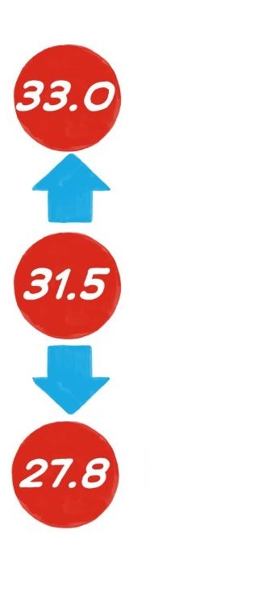
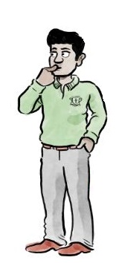
Rule 7.1a - Adjusting a Player’s Handicap Index
When a handicap review has been completed, the Handicap Committee can adjust a player’s Handicap Index to better reflect their demonstrated ability, based on the results of the analysis reports.
The adjustment must satisfy the following criteria:
Be a minimum of 1 full stroke.
Except in exceptional circumstance, only increase a player’s Handicap Index by up to 5.0 strokes above their Low Handicap Index.
There is no limit as too how far downwards a Handicap Index can be adjusted.

Slide 87
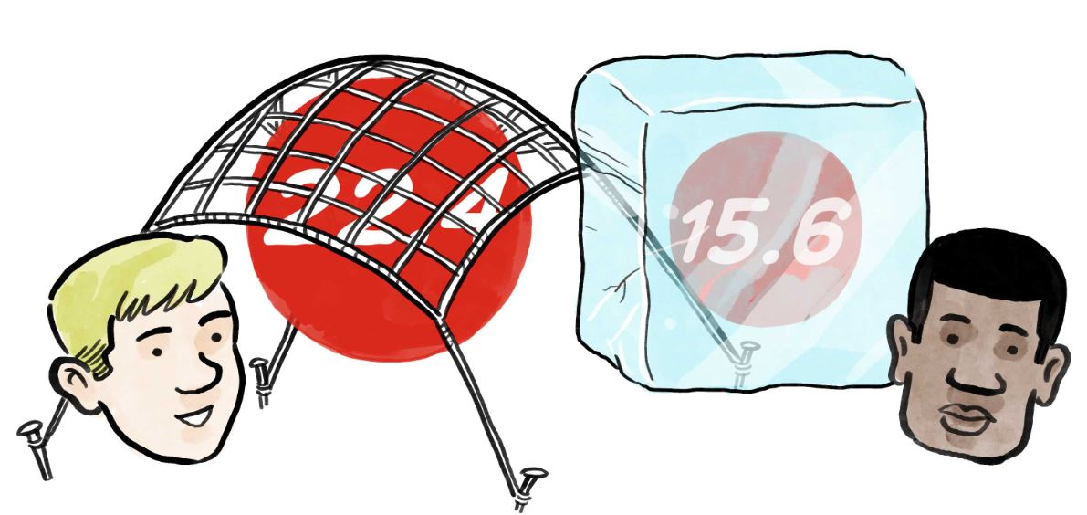
Rule 7.1 a - Adjusting a Player’s Handicap Index
Adjustments can be made by:
Resetting the Handicap Index by applying an adjustment to each of the most recent 20 score differentials in the scoring record, to achieve the chosen Handicap Index.(Interpretation 7.1a/1).
OR
Resetting and/or freezing a Handicap Index for a defined period of time.
If required, the Handicap Committee should consult with the Authorised Association before adjusting a player’s Handicap Index.
Notes:
An Authorized Association has the discretion to require:
upward adjustments of a Handicap Index in excess of a defined number of strokes to be sanctioned or ratified.
reductions to a Handicap Index below a certain level of Handicap Index to be sanctioned or ratified

Slide 88
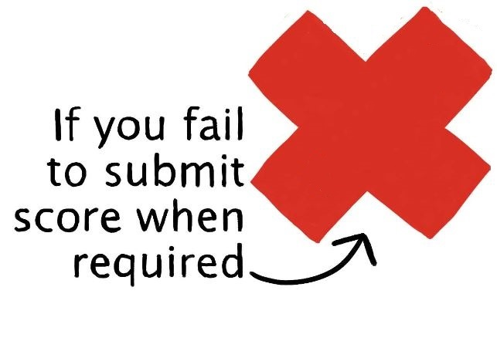
Rule 7.1b - Applying a Penalty Score
If a player fails to submit a score from an authorised format of play, the Handicap Committee should investigate and take appropriate action.
If the reason was valid and an acceptable score is still discoverable, that score will be posted.
If there was no valid reason and an acceptable score is discoverable, that score will be posted.
If the score is not discoverable, a penalty score may be posted.
In the most serious cases, such as repeated failure to submit acceptable scores, the Committee has discretion to apply additional penalty scores, reset the player’s Handicap Index or consider other disciplinary procedures.
PENALTY
SCORE
Notes:
Important safeguard.

Slide 89

Rule 7.1c - Withdrawing a Handicap Index
A player’s Handicap Index should be withdrawn if they deliberately or repeatedly fail to comply with their responsibilities under the Rules of Handicapping.
A player must be notified of the period of Handicap Index withdrawal and any additional conditions.
The withdrawal of a player’s Handicap Index should be applied only after the player has been informed and has had an opportunity to respond.
This process can be handled by the Club Handicap Committee or the CGF HR&CRC.

Slide 90

Rule 7.2 - Competition Committee
The Committee in charge of a competition may set eligibility conditions within their Terms of the Competition.
For example:
    A maximum Handicap Index limit for entry.
    A maximum Course Handicap limit.
    A maximum Playing Handicap.
A Committee may also set the Playing Handicap for a player:
    If it has not been updated since the last round was played, or
    If there is evidence to suggest that the Handicap Index does not reflect their ability

Slide 91

Rule 7.2a - Multi-round Competitions
For competitions played on the same day or consecutive days, it is strongly recommended that the Handicap Index used at the start of the competition is used for the duration of the event.
This is for ease of competition administration purposes.
This provision should be stated clearly in the Terms of the Competition.
Scores should still be posted by the end of each day.
Printing of scorecards or labels with up to date information might need to be delayed until the morning of the next day.
Notes:
Ultimately, however, it is up to the Committee to decide.

Slide 92
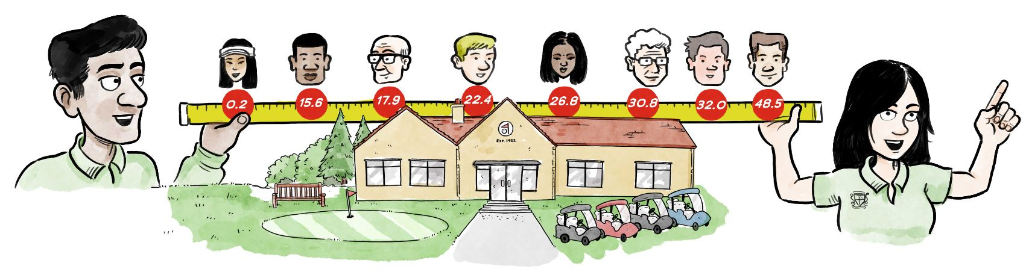
Impact on Committees ?
Ensuring scores are submitted promptly after round or by end of day.
Processing scores as soon as possible after the end of the day.
Conducting Handicap Reviews.
Establishing Terms of Competition with information about Handicap Index to use.
Acting as Home Club or collaborating with a player’s Home Club.
Understanding rights and responsibilities as delegated by a National Association.

Slide 93
Key Messaging
Inclusive & Accessible
The new World Handicap System welcomes everyone to compete or play socially with anyone on a fair and equal basis, helping to make golf a more enjoyable game.
The World Handicap System provides a consistent method of measuring skill-level and produces handicaps that are portable from course to course, country to country.
Consistent & Portable
Modern & Adaptable
The World Handicap System is modern, adaptable across golfing cultures and easy to use.

Slide 94
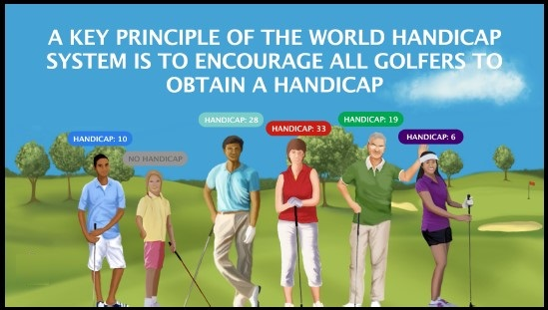
Communication
Raise awareness that the World Handicap System is scheduled to be adopted in Cyprus on Saturday 1 Feb 20.
Players will be able to use a DataGolf application to self submit casual round scores. To do so they MUST ensure their correct e-mail address is recorded in their club DataGolf records.
Reinforcement of key messages – steer members to review the very simple WHS videos on the CGF website
Remind them to be wary of magazine articles which are from outside the EGA area of responsibility

Slide 95
Thank you!

